Slide 1
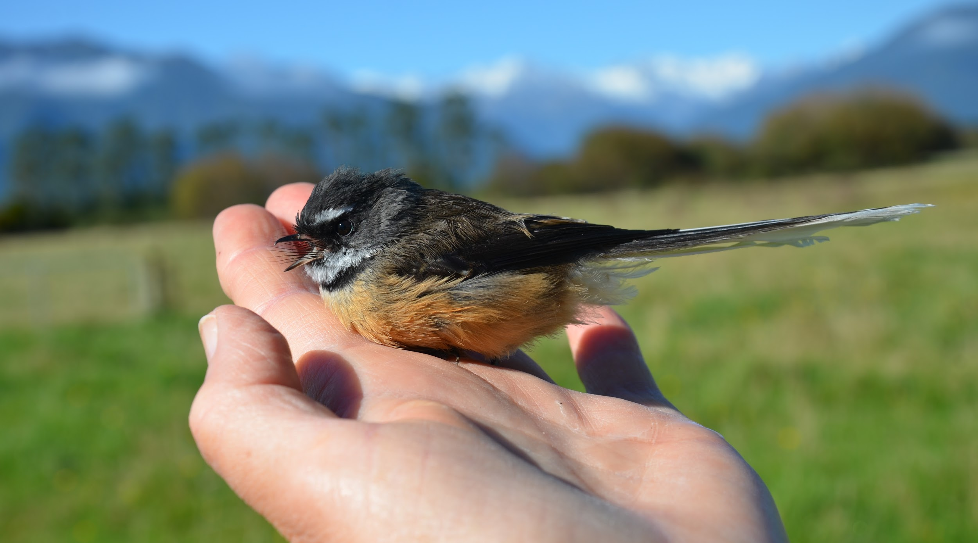
… to care for creation
Teach us to discover the worth
of each thing, to be filled with awe and contemplation,
HAERE TUKUNA
to recognize that we are profoundly
UNITED with every creature
POPE FRANCIS - 2015
Notes:
SYNOD PRIORITY 8
TE WHAINGA MATUA 8 O TE HĪKOI TAHI
GO YOU ARE SENT … to care for creation
HAERE TUKUNA ... ki te manaaki i te ao tūroa
“Teach us to discover the worth of each thing, to be filled with awe and contemplation, to recognize that we are profoundly UNITED with every creature”
“Akohia mai kia kite atu te mana o ngā mea katoa, ā kia ihiihi, kia whaiwhakaaro, ā, kia mārama ai tātou KOTAHI te manatapu o ngā mea katoa.”
Pope Francis
Pāpā Werahiko
ENCYCLICAL LETTER: LAUDATO SI’
OF THE HOLY FATHER FRANCIS ON CARE FOR OUR COMMON HOME [2015]
F U L L T E X T
A prayer for our earth
All-powerful God, you are present in the whole universe and in the smallest of your creatures. You embrace with your tenderness all that exists. Pour out upon us the power of your love, that we may protect life and beauty.
Fill us with peace, that we may live as brothers and sisters, harming no one. O God of the poor, help us to rescue the abandoned and forgotten of this earth, so precious in your eyes. Bring healing to our lives, that we may protect the world and not prey on it, that we may sow beauty, not pollution and destruction. Touch the hearts of those who look only for gain at the expense of the poor and the earth. Teach us to discover the worth of each thing, to be filled with awe and contemplation, to recognize that we are profoundly united with every creature as we journey towards your infinite light. We thank you for being with us each day. Encourage us, we pray, in our struggle for justice, love and peace.
Translations prepared by Deacon Danny Karatea-Goddard, July 2018

