Slide 1
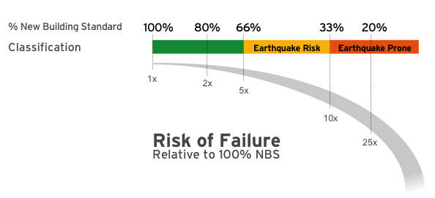
CLOSURE NOTICE
Engineers have assessed the seismic performance of this building as
EARTHQUAKE PRONE
meaning that you may not be safe inside or near this building during or after a moderate to severe earthquake.
No person must enter this building without
express permission
FOR MORE INFORMATION CONTACT:
www.stronger.org.nz

Slide 2
HAZARD NOTICE
Engineers have assessed the seismic performance of this building as potentially
EARTHQUAKE PRONE
meaning that you may not be safe inside or near this building during or after a moderate to severe earthquake.
This building may be used while we await further investigation, consultation, and a decision on ongoing use
Every person must make their own judgment about entering this building.
12%
FOR MORE INFORMATION CONTACT:
www.stronger.org.nz

Slide 3
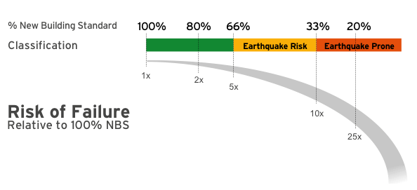
SAFETY NOTICE
Engineers have assessed the seismic performance of this building as potentially an
EARTHQUAKE RISK
meaning that you may not be safe inside or near this building during or after a moderate to severe earthquake.
Every person must make their own judgment about entering this building.
FOR MORE INFORMATION CONTACT:
www.stronger.org.nz

Slide 4
SAFETY NOTICE
Engineers have assessed the seismic performance of this building as
LOW RISK
meaning that there is a low risk of building failure during or after a moderate to severe earthquake.
.
FOR MORE INFORMATION CONTACT:
www.stronger.org.nz

Slide 5
SAFETY NOTICE
Engineers have assessed the seismic performance of this building as
LOW RISK
meaning that there is a low risk of building failure during or after a moderate to severe earthquake.
.
FOR MORE INFORMATION CONTACT:
www.stronger.org.nz

