Slide 1
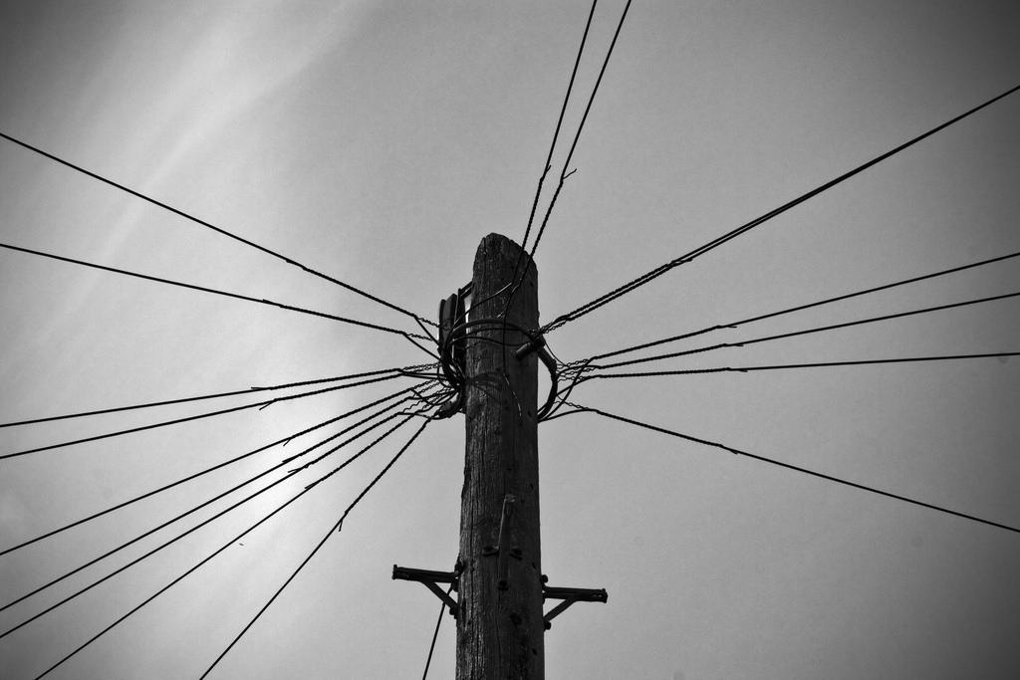
. . . to communicate effectively
COMMUNICATING
means SHARING
and sharing demands LISTENING and ACCEPTANCE
POPE FRANCIS - 2016
HAERE TUKUNA
Notes:
SYNOD PRIORITY 13
TE WHAINGA MATUA 13 O TE HĪKOI TAHI
GO YOU ARE SENT … to communicate effectively
HAERE TUKUNA … kia mārama ai te whakawhiti korero
“Communicating means sharing, and sharing demands listening and acceptance.“
“He tohu te whakawhiti kōrero o te whakarongo atu me te whakarongo mai, ko te tikanga me whakarongo, me whakamana.”
Pope Francis
Pāpā Werahiko
MESSAGE OF HIS HOLINESS POPE FRANCIS FOR THE 50th WORLD COMMUNICATIONS DAY
Communication and Mercy: A Fruitful Encounter
F U L L T E X T
Dear Brothers and Sisters,
The Holy Year of Mercy invites all of us to reflect on the relationship between communication and mercy. The Church, in union with Christ, the living incarnation of the Father of Mercies, is called to practise mercy as the distinctive trait of all that she is and does. What we say and how we say it, our every word and gesture, ought to express God’s compassion, tenderness and forgiveness for all. Love, by its nature, is communication; it leads to openness and sharing. If our hearts and actions are inspired by charity, by divine love, then our communication will be touched by God’s own power.
As sons and daughters of God, we are called to communicate with everyone, without exception. In a particular way, the Church’s words and actions are all meant to convey mercy, to touch people’s hearts and to sustain them on their journey to that fullness of life which Jesus Christ was sent by the Father to bring to all. This means that we ourselves must be willing to accept the warmth of Mother Church and to share that warmth with others, so that Jesus may be known and loved. That warmth is what gives substance to the word of faith; by our preaching and witness, it ignites the “spark” which gives them life.
Communication has the power to build bridges, to enable encounter and inclusion, and thus to enrich society. How beautiful it is when people select their words and actions with care, in the effort to avoid misunderstandings, to heal wounded memories and to build peace and harmony. Words can build bridges between individuals and within families, social groups and peoples. This is possible both in the material world and the digital world. Our words and actions should be such as to help us all escape the vicious circles of condemnation and vengeance which continue to ensnare individuals and nations, encouraging expressions of hatred. The words of Christians ought to be a constant encouragement to communion and, even in those cases where they must firmly condemn evil, they should never try to rupture relationships and communication.
For this reason, I would like to invite all people of good will to rediscover the power of mercy to heal wounded relationships and to restore peace and harmony to families and communities. All of us know how many ways ancient wounds and lingering resentments can entrap individuals and stand in the way of communication and reconciliation. The same holds true for relationships between peoples. In every case, mercy is able to create a new kind of speech and dialogue. Shakespeare put it eloquently when he said: “The quality of mercy is not strained. It droppeth as the gentle rain from heaven upon the place beneath. It is twice blessed: it blesseth him that gives and him that takes” (The Merchant of Venice, Act IV, Scene I).
Our political and diplomatic language would do well to be inspired by mercy, which never loses hope. I ask those with institutional and political responsibility, and those charged with forming public opinion, to remain especially attentive to the way they speak of those who think or act differently or those who may have made mistakes. It is easy to yield to the temptation to exploit such situations to stoke the flames of mistrust, fear and hatred. Instead, courage is needed to guide people towards processes of reconciliation. It is precisely such positive and creative boldness which offers real solutions to ancient conflicts and the opportunity to build lasting peace. “Blessed are the peacemakers, for they will be called children of God” (Mt 5:7-9)
How I wish that our own way of communicating, as well as our service as pastors of the Church, may never suggest a prideful and triumphant superiority over an enemy, or demean those whom the world considers lost and easily discarded. Mercy can help mitigate life’s troubles and offer warmth to those who have known only the coldness of judgment. May our way of communicating help to overcome the mindset that neatly separates sinners from the righteous. We can and we must judge situations of sin – such as violence, corruption and exploitation – but we may not judge individuals, since only God can see into the depths of their hearts. It is our task to admonish those who err and to denounce the evil and injustice of certain ways of acting, for the sake of setting victims free and raising up those who have fallen. The Gospel of John tells us that “the truth will make you free” (Jn 8:32). The truth is ultimately Christ himself, whose gentle mercy is the yardstick for measuring the way we proclaim the truth and condemn injustice. Our primary task is to uphold the truth with love (cf. Eph 4:15). Only words spoken with love and accompanied by meekness and mercy can touch our sinful hearts. Harsh and moralistic words and actions risk further alienating those whom we wish to lead to conversion and freedom, reinforcing their sense of rejection and defensiveness.
Some feel that a vision of society rooted in mercy is hopelessly idealistic or excessively indulgent. But let us try and recall our first experience of relationships, within our families. Our parents loved us and valued us for who we are more than for our abilities and achievements. Parents naturally want the best for their children, but that love is never dependent on their meeting certain conditions. The family home is one place where we are always welcome (cf. Lk 15:11-32). I would like to encourage everyone to see society not as a forum where strangers compete and try to come out on top, but above all as a home or a family, where the door is always open and where everyone feels welcome.
For this to happen, we must first listen. Communicating means sharing, and sharing demands listening and acceptance. Listening is much more than simply hearing. Hearing is about receiving information, while listening is about communication, and calls for closeness. Listening allows us to get things right, and not simply to be passive onlookers, users or consumers. Listening also means being able to share questions and doubts, to journey side by side, to banish all claims to absolute power and to put our abilities and gifts at the service of the common good.
Listening is never easy. Many times it is easier to play deaf. Listening means paying attention, wanting to understand, to value, to respect and to ponder what the other person says. It involves a sort of martyrdom or self-sacrifice, as we try to imitate Moses before the burning bush: we have to remove our sandals when standing on the “holy ground” of our encounter with the one who speaks to me (cf. Ex 3:5). Knowing how to listen is an immense grace, it is a gift which we need to ask for and then make every effort to practice.
Emails, text messages, social networks and chats can also be fully human forms of communication. It is not technology which determines whether or not communication is authentic, but rather the human heart and our capacity to use wisely the means at our disposal. Social networks can facilitate relationships and promote the good of society, but they can also lead to further polarization and division between individuals and groups. The digital world is a public square, a meeting-place where we can either encourage or demean one another, engage in a meaningful discussion or unfair attacks. I pray that this Jubilee Year, lived in mercy, “may open us to even more fervent dialogue so that we might know and understand one another better; and that it may eliminate every form of closed-mindedness and disrespect, and drive out every form of violence and discrimination” (Misericordiae Vultus, 23). The internet can help us to be better citizens. Access to digital networks entails a responsibility for our neighbour whom we do not see but who is nonetheless real and has a dignity which must be respected. The internet can be used wisely to build a society which is healthy and open to sharing.
Communication, wherever and however it takes place, has opened up broader horizons for many people. This is a gift of God which involves a great responsibility. I like to refer to this power of communication as “closeness”. The encounter between communication and mercy will be fruitful to the degree that it generates a closeness which cares, comforts, heals, accompanies and celebrates. In a broken, fragmented and polarized world, to communicate with mercy means to help create a healthy, free and fraternal closeness between the children of God and all our brothers and sisters in the one human family.
From the Vatican, 24 January 2016
Translations prepared by Deacon Danny Karatea-Goddard, July 2018

