Slide 1
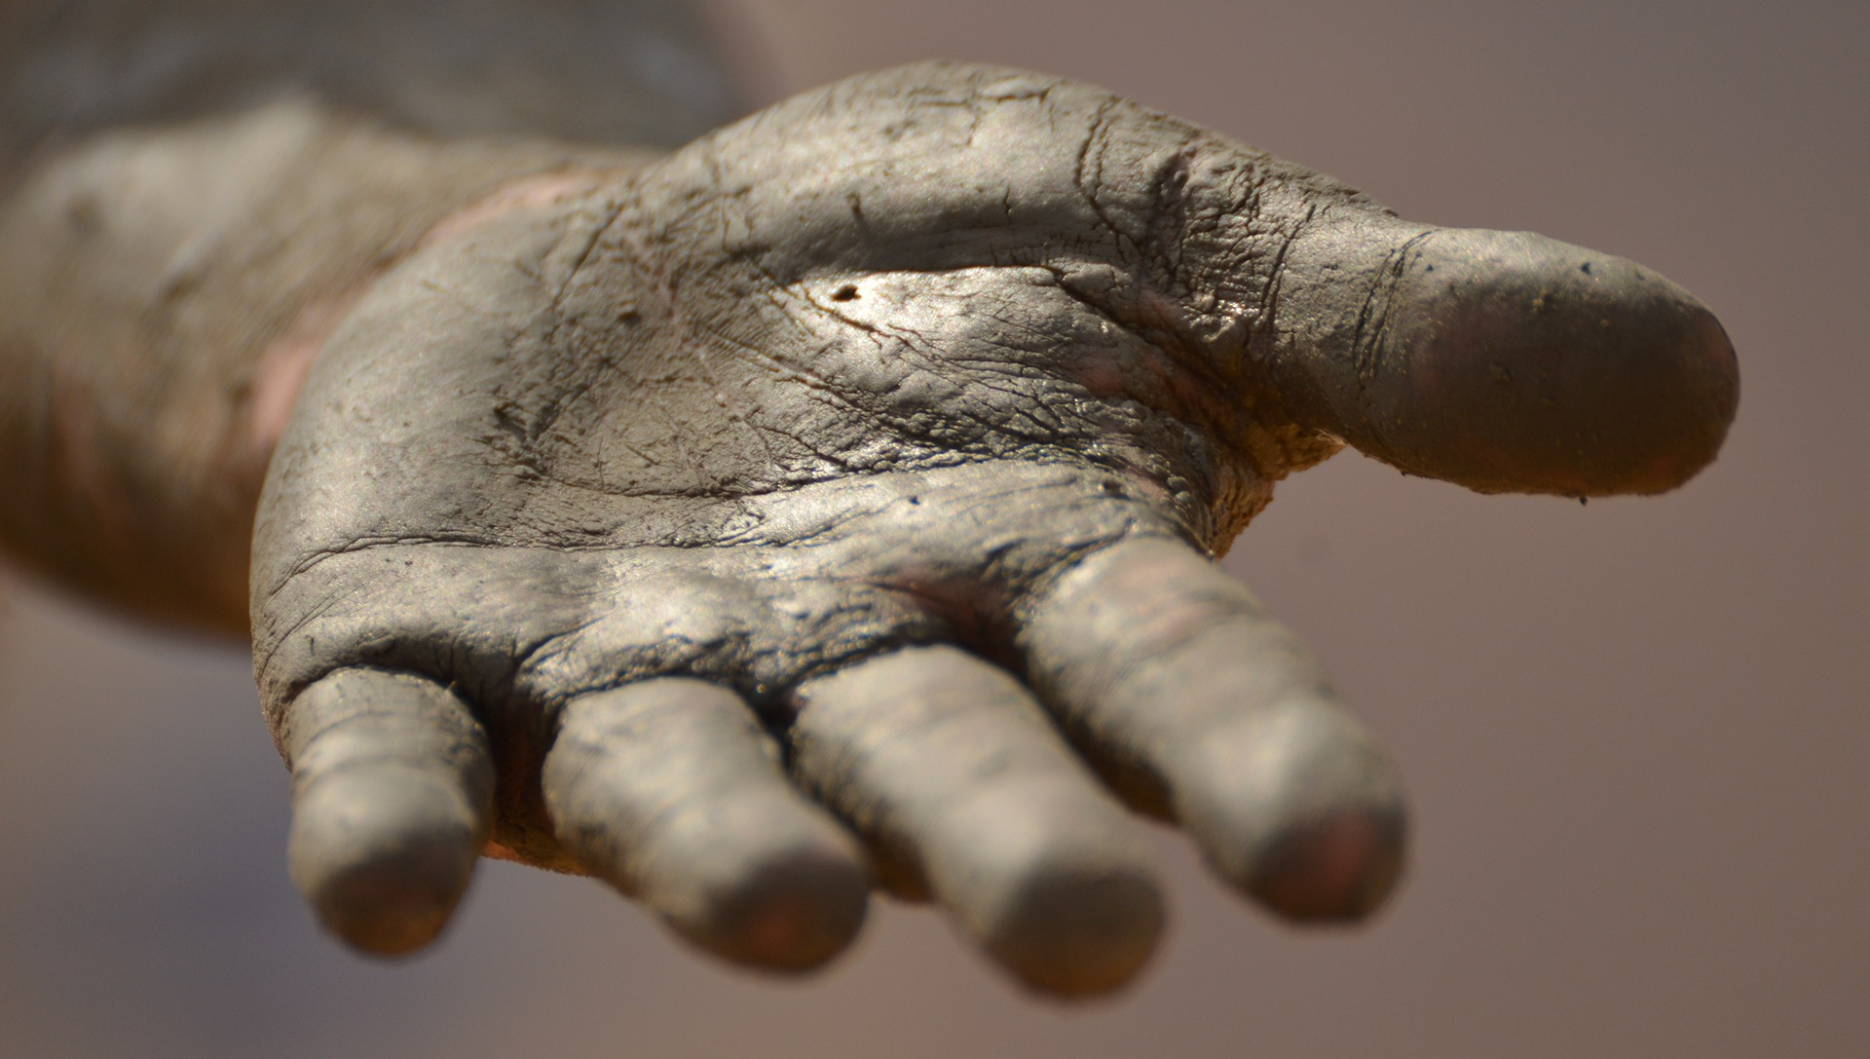
… to find leaders
Among us, who is above must be
IN SERVICE of the others.
HAERE TUKUNA
This doesn't mean
we have to wash
each other's feet every day, but
WE MUST HELP ONE ANOTHER
POPE FRANCIS - 2013
Notes:
SYNOD PRIORITY 3
TE WHAINGA MATUA 3 O TE HĪKOI TAHI
GO YOU ARE SENT … to find leaders
HAERE TUKUNA … ki te rapu kaiarahi
“Among us, who is above must be in service of the others. This doesn't mean we have to wash each other's feet every day, but we must help one another”.
“Mō mātou, ME MANAAKIHIA ĒTEHI ATU e te tangata e noho ana ki runga ake. Ko te tikanga o tēnei, ehara i te mea me horoia ngā waewae o tētehi atu i a rā, hēoi anō me manaaki tātou i a tātou.”
Pope Francis
Pāpā Werahiko
Pope washes feet of two girls, two Muslims at youth prison
Christians are in the middle of Holy Week ceremonies leading up to Easter Sunday.
By Alessandro Speciale, Religion News Service [March 28, 2013]
F U L L T E X T
VATICAN CITY
Pope Francis on Thursday (March 28) washed the feet of 12 young inmates, including two girls and two Muslims, during a Maundy Thursday Mass at a youth detention center in Rome.
The Argentine pontiff, who has shown an eagerness to break with tradition in the two weeks since his election to the papacy on March 13, chose to celebrate the rite in the Casal del Marmo prison in northwest Rome, rather than in the traditional venue of the St. John Lateran Basilica.
Francis has repeatedly stated his desire to bring the papacy and the church closer to the poor and the marginalized.
The inclusion of two women in the rite — which commemorates Jesus’ washing of the feet of the apostles on the night before his death — is also a first for a pope, but Francis had already done so as archbishop of Buenos Aires.
As all of Jesus’ apostles were men, popes usually washed the feet of 12 male priests. Outside the Vatican, many bishops will wash only the feet of men.
In a brief, unscripted homily, Francis explained that the foot-washing ceremony exemplifies Jesus’ message that men — including those in positions of power and authority — must be in service of each other.
“Among us, who is above must be in service of the others,” he said. “This doesn’t mean we have to wash each other’s feet every day, but we must help one another.” Media access to the youth prison was limited since most inmates are minors, but the Vatican’s chief spokesman, the Rev. Federico Lombardi, reported that Francis knelt in front of the 12 youths and kissed their feet after having washed and dried them.
“It was an impressive gesture,” he said, adding that it was also “physically taxing.”
After the Mass, the pope personally greeted all the inmates as well as the prison’s staff and volunteers. “Do not let yourselves be robbed of hope,” he told the young offenders before leaving.
The Casal del Marmo youth prison houses 49 inmates aged 14-21, mostly coming from North Africa and Eastern Europe.
Earlier on Thursday, at a solemn Mass in St. Peter’s Basilica that marks the beginning of Easter celebrations for the Catholic Church, Francis called on priests to avoid becoming “managers” and “collectors of antiques or novelties.”
He urged them to “go out of themselves,” into the “outskirts where there is suffering, bloodshed, blindness that longs for sight, and prisoners in thrall to many evil masters.”
Copyright: For copyright information, please check with the distributor of this item, Religion News Service LLC.
Translations prepared by Deacon Danny Karatea-Goddard, July 2018

