Slide 1
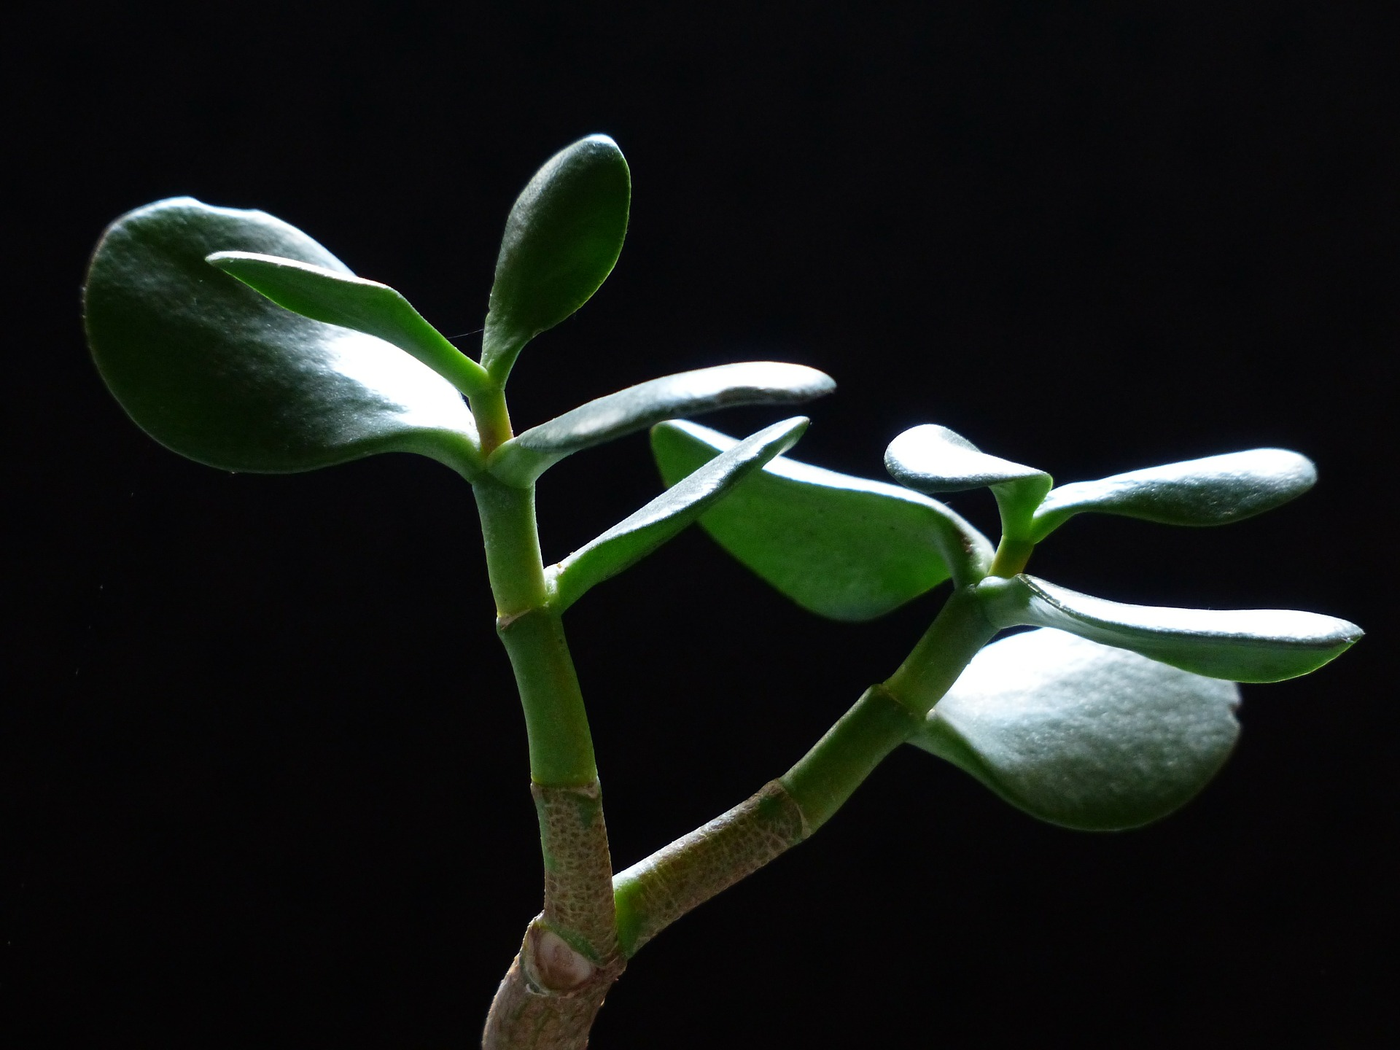
HAERE TUKUNA
… to manage your assets wisely
For where your treasure is,
there your heart will be also
LUKE 12: 34
Notes:
SYNOD PRIORITY 4
TE WHAINGA MATUA 4 O TE HĪKOI TAHI
GO YOU ARE SENT … to manage your assets wisely
HAERE TUKUNA … ki te āta manaaki i ngā rawa
“For where your treasure is, there your heart will be also”
“Kei kōnā te taonga, kei kōnā hoki tōu ngākau”
Luke 12: 34
Ruka 12: 34
F U L L T E X T
Do Not Be Anxious
²² And he said to his disciples, “Therefore I tell you, do not be anxious about your life, what you will eat, nor about your body, what you will put on.
²³ For life is more than food, and the body more than clothing.
²⁴ Consider the ravens: they neither sow nor reap, they have neither storehouse nor barn, and yet God feeds them. Of how much more value are you than the birds!
²⁵ And which of you by being anxious can add a single hour to his span of life?^{[c]}
²⁶ If then you are not able to do as small a thing as that, why are you anxious about the rest?
²⁷ Consider the lilies, how they grow: they neither toil nor spin,^{[d]} yet I tell you, even Solomon in all his glory was not arrayed like one of these.
²⁸ But if God so clothes the grass, which is alive in the field today, and tomorrow is thrown into the oven, how much more will he clothe you, O you of little faith!
²⁹ And do not seek what you are to eat and what you are to drink, nor be worried.
³⁰ For all the nations of the world seek after these things, and your Father knows that you need them.
³¹ Instead, seek his^{[e]}kingdom, and these things will be added to you.
³² “Fear not, little flock, for it is your Father's good pleasure to give you the kingdom.
³³ Sell your possessions, and give to the needy. Provide yourselves with moneybags that do not grow old, with a treasure in the heavens that does not fail, where no thief approaches and no moth destroys.
³⁴ For where your treasure is, there will your heart be also.
Translations prepared by Deacon Danny Karatea-Goddard, July 2018

