Slide 1
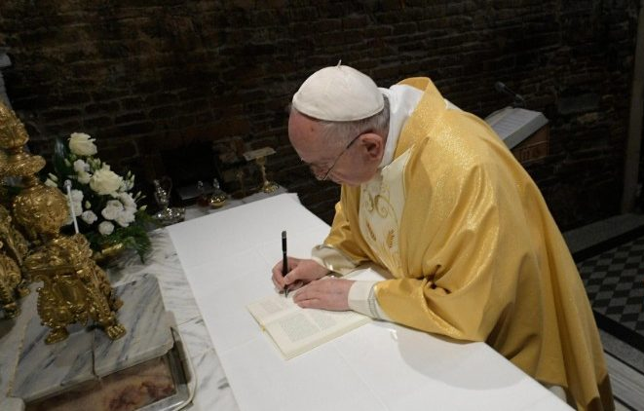


Slide 2
“Whatever you do, don’t become the sorry sight of an abandoned vehicle! Don’t be parked cars, but dream freely and make good decisions. Take risks, even if it means making mistakes. Don’t go through life anesthetized or approach the world like tourists. Make a ruckus! Cast out the fears that paralyze you, so that you don’t become young mummies. Live! Give yourselves over to the best of life! Open the door of the cage, go out and fly! Please, don’t take an early retirement.”

Slide 3



Slide 4
Response? (observations, reflection, thoughts)
How do we do this in our college/ministry?

Slide 5

1. Reflect Christ
Even though to many young people, God, religion and the Church seem empty words, they are sensitive to the figure of Jesus when he is presented in an attractive and effective way. Consequently, the Church should not be excessively caught up in herself but instead, and above all, reflect Jesus Christ. This means humbly acknowledging that some things concretely need to change, and if that is to happen, she needs to appreciate the vision but also the criticisms of young people. "Christ is alive and he wants you to be alive!“ (CV 39)
Notes:
As people who love young people, our first job is to reflect Jesus Christ.

Slide 6
1. Reflect Christ
… above all, reflect Jesus Christ. This means (CV 39)
Response? (observations, reflection, thoughts)
How do we do this in our college/ministry?
Notes:
As people who love young people, our first job is to reflect Jesus Christ.

Slide 7

2. Be young at heart (1/3)
To be credible to young people, there are times when (the Church) needs to regain her humility and simply listen, recognizing that what others have to say can provide some light to help her better understand the Gospel. A Church always on the defensive, which loses her humility and stops listening to others, which leaves no room for questions, loses her youth and turns into a museum. How, then, will she be able to respond to the dreams of young people?
(CV 41)
Notes:
​In this letter, Pope Francis demonstrates that God views youthfulness differently. He encourages all of us to be young at heart. To be youthful is to be capable of loving. To grow old is to be stagnant, and attached to things that pass away. We are reminded that Jesus did not tolerate those who dismissed the young.

Slide 8
2. Be young at heart (2/3)
…true youth means having a heart capable of loving, whereas everything that separates us from others makes the soul grow old. And so he (Paul) concludes: “above all, clothe yourselves with love, which binds everything together in perfect harmony”(Col 3:14).
(CV 13)
Notes:
​In this letter, Pope Francis demonstrates that God views youthfulness differently. He encourages all of us to be young at heart. To be youthful is to be capable of loving. To grow old is to be stagnant, and attached to things that pass away. We are reminded that Jesus did not tolerate those who dismissed the young.

Slide 9
2. Be young at heart (3/3)
Let us ask the Lord to free the Church from those who would make her grow old, encase her in the past, hold her back or keep her at a standstill. … The Church is young when she is herself, when she receives ever anew the strength born of God's word, the Eucharist, and the daily presence of Christ and the power of his Spirit in our lives. The Church is young when she shows herself capable of constantly returning to her source.
(CV 35)
Notes:
​In this letter, Pope Francis demonstrates that God views youthfulness differently. He encourages all of us to be young at heart. To be youthful is to be capable of loving. To grow old is to be stagnant, and attached to things that pass away. We are reminded that Jesus did not tolerate those who dismissed the young.

Slide 10
2. Be young at heart (1/3)
…true youth means having a heart capable of loving, whereas everything that separates us from others makes the soul grow old
…a Church always on the defensive, which loses her humility and stops listening to others, which leaves no room for questions, loses her youth and turns into a museum
…the Church is young when she shows herself capable of constantly returning to her source
(CV 41, 13, 35)
Response? (observations, reflection, thoughts)
How do we do this in our college/ministry?
Notes:
​In this letter, Pope Francis demonstrates that God views youthfulness differently. He encourages all of us to be young at heart. To be youthful is to be capable of loving. To grow old is to be stagnant, and attached to things that pass away. We are reminded that Jesus did not tolerate those who dismissed the young.

Slide 11

3. Take young people seriously
I encourage communities to examine, respectfully and seriously, the situation of their young people, in order to find the most fitting ways of providing them with pastoral care. (CV 103)
Each young person's heart should thus be considered ‘holy ground’, a bearer of seeds of divine life, before which we must "take off our shoes" in order to draw near and enter more deeply into the Mystery.
(CV 67)
Notes:
​Walking with youth in faith begins with our stance of truly seeing them, hearing their story, and responding.

Slide 12
3. Take young people seriously
I … examine, respectfully and seriously, the situation of young people, in order to find the
…each young person's heart should thus be considered ‘holy ground’, a bearer of seeds of
(CV 103, 67)
Response? (observations, reflection, thoughts)
How do we do this in our college/ministry?
Notes:
​Walking with youth in faith begins with our stance of truly seeing them, hearing their story, and responding.

Slide 13

4. Listen to young people & stay close to their concerns (1/2)
Those of us who are no longer young need to find ways of keeping close to the voices and concerns of young people. Drawing together creates the conditions for the Church to become a place of dialogue and a witness to life-giving fraternity. We need to make more room for the voices of young people to be heard: listening makes possible an exchange of gifts in a context of empathy… at the same time, it sets the conditions for a preaching of the Gospel that can touch the heart truly, decisively and fruitfully. (CV 38)
Notes:
​Young people often experience us as ready to jump in with the answer. Throughout the Synod process, we have been consistently urged to listen to youth.

Slide 14
4. Listen to young people & stay close to their concerns (2/2)
Rather than listening to young people attentively, all too often, there is a tendency to provide prepackaged answers and ready-made solutions, without allowing their real questions to emerge and facing the challenges they pose. Yet once the Church sets aside narrow preconceptions and listens carefully to the young, this empathy enriches her, for it allows young people to make their own contribution to the community, helping it to appreciate new sensitivities and to consider new questions. (CV 65)
Notes:
​Young people often experience us as ready to jump in with the answer. Throughout the Synod process, we have been consistently urged to listen to youth.

Slide 15
4. Listen to young people & stay close to their concerns (1/2)
… keeping close to the voices and concerns of young people
… once the Church sets aside narrow preconceptions and listens carefully to the young, this empathy enriches her
questions". (CV 38, 65)
Response? (observations, reflection, thoughts)
How do we do this in our college/ministry?
Notes:
​Young people often experience us as ready to jump in with the answer. Throughout the Synod process, we have been consistently urged to listen to youth.

Slide 16

5. Be flexible
The young make us see the need for new styles and new strategies. For example, while adults often worry about having everything properly planned, with regular meetings and fixed times, most young people today have little interest in this kind of pastoral approach. Youth ministry needs to become more flexible: inviting young people to events or occasions that provide an opportunity not only for learning, but also for conversing, celebrating, singing, listening to real stories and experiencing a shared encounter with the living God. (CV 67)
Notes:
​Pope Francis is urging us to make room for the spontaneity and enthusiasm of young people. In the preparatory document, we were warned of creating ministries that "dominate space." Instead we create space with room to breathe, where community can grow, and faith can be shared.

Slide 17
5. Be flexible
… youth ministry needs to become more flexible
.(CV 67)
Response? (observations, reflection, thoughts)
How do we do this in our college/ministry?
Notes:
​Pope Francis is urging us to make room for the spontaneity and enthusiasm of young people. In the preparatory document, we were warned of creating ministries that "dominate space." Instead we create space with room to breathe, where community can grow, and faith can be shared.

Slide 18

6. Empower young people for mission
This involves growing in a relationship with the Father, in awareness of being part of a family and a people, and in openness to being filled with the Holy Spirit and led to carry out the mission God gives them, their personal vocation. … we need projects that can strengthen them, accompany them and impel them to encounter others, to engage in generous service, in mission. (CV 30)
Notes:
Growing in faith means growing in our awareness of our mission. Those of us who walk with youth have the privilege of providing ways to encourage and empower youth for service.

Slide 19
6. Empower young people
for mission
… strengthen them, accompany them and impel them to encounter others, to engage in generous service, in mission.
(CV 30)
Response? (observations, reflection, thoughts)
How do we do this in our college/ministry?
Notes:
Growing in faith means growing in our awareness of our mission. Those of us who walk with youth have the privilege of providing ways to encourage and empower youth for service.

Slide 20

7. Awaken young people to encounter
- don’t bore them!
…it happens that young people are helped to have a powerful experience of God, an encounter with Jesus that touched their hearts. But the only follow-up to this is a series of "formation" meetings featuring talks about doctrinal and moral issues, the evils of today's world, the Church, her social doctrine, chastity, marriage, birth control and so on. As a result, many young people get bored, they lose the fire of their encounter with Christ and the joy of following him; many give up and others become downcast or negative. Rather than being too concerned with communicating a great deal of doctrine, let us first try to awaken and consolidate the great experiences that sustain the Christian life. (CV 212)
Notes:
​Our generous God is always sending opportunities for encounter to young people. We are told to awaken youth to these encounters and consolidate these experiences to sustain discipleship. We are also warned – don't bore young people. Sometimes we allow our fear to dominate what we share with the young and how we spend our time.

Slide 21
7. Awaken young people to encounter
- don’t bore them!
… many young people get bored, they lose the fire of their encounter with Christ and the joy of following him;
(CV 212)
Response? (observations, reflection, thoughts)
How do we do this in our college/ministry?
Notes:
​Our generous God is always sending opportunities for encounter to young people. We are told to awaken youth to these encounters and consolidate these experiences to sustain discipleship. We are also warned – don't bore young people. Sometimes we allow our fear to dominate what we share with the young and how we spend our time.

Slide 22

8. Make a home for all young people
(1/2)
…The Gospel also asks us to be daring, and we want to be so, without presumption and without proselytizing, testifying to the love of the Lord and stretching out our hands to all the young people in the world. (CV 235)
The Synod called for the development of a youth ministry capable of being inclusive, with room for all kinds of young people, to show that we are a Church with open doors. …we need a "popular" youth ministry that can open doors and make room for everyone, with their doubts and frustrations, their problems and their efforts to find themselves, their past errors, their experiences of sin and all their difficulties. (CV 234)
Notes:
The Instrumentum Laboris document from the Synod reminded us of our call as Church to "accompany all young people, without exception, towards the joy of love." (#1) In Christ Lives, we are told to be bold and daring in making a home for all young people.

Slide 23
8. Make a home for all young people
(2/2)
In a word, to create a ‘home’ is to create ‘a family’. It is to learn to feel connected to others by more than merely utilitarian and practical bonds, to be united in such a way as to feel that our life is a bit more human. (CV 217)
…provide young people with places they can make their own, where they can come and go freely, feel welcome and readily meet other young people, whether at times of difficulty and frustration, or of joy and celebration. (CV 218)
Notes:
The Instrumentum Laboris document from the Synod reminded us of our call as Church to "accompany all young people, without exception, towards the joy of love." (#1) In Christ Lives, we are told to be bold and daring in making a home for all young people.

Slide 24
8. Make a home for all young people
)
… to create a ‘home’ is to create ‘a family’
… testifying to the love of the Lord and stretching out our hands to all the young people in the world
… to show that we are a Church with open doors
… feel welcome and readily meet other young people
(CV 217, 218, 234, 235)
Response? (observations, reflection, thoughts)
How do we do this in our college/ministry?
Notes:
The Instrumentum Laboris document from the Synod reminded us of our call as Church to "accompany all young people, without exception, towards the joy of love." (#1) In Christ Lives, we are told to be bold and daring in making a home for all young people.

Slide 25

9. Build families & communities that welcome youth and radiate Christ
…the family continues to be the principal point of reference for young people. Children appreciate the love and care of their parents, they give importance to family bonds, and they hope to succeed in forming a family when it is their time. (CV 262)
The community has an important role in the accompaniment of young people; it should feel collectively responsible for accepting, motivating, encouraging and challenging them. All should regard young people with understanding, appreciation and affection, and avoid constantly judging them or demanding of them a perfection beyond their years. (CV 243)
Notes:
​Pope Francis is urging us to make room for the spontaneity and enthusiasm of young people. In the preparatory document, we were warned of creating ministries that "dominate space." Instead we create space with room to breathe, where community can grow, and faith can be shared.

Slide 26
9. Build families & communities that welcome youth and radiate Christ
… family continues to be the principal point of reference
… the community has an important role in the accompaniment of young people; it should feel
(CV 262, 243)
Response? (observations, reflection, thoughts)
How do we do this in our college/ministry?
Notes:
​Pope Francis is urging us to make room for the spontaneity and enthusiasm of young people. In the preparatory document, we were warned of creating ministries that "dominate space." Instead we create space with room to breathe, where community can grow, and faith can be shared.

Slide 27

10. Accompany the young (1/2)
Jesus walks with two disciples who did not grasp the meaning of all that happened to him, and are leaving Jerusalem and the community behind. Wanting to accompany them, he joins them on the way. He asks them questions and listens patiently to their version of events, and in this way he helps them recognize what they were experiencing. Then, with affection and power, he proclaims the word to them, leading them to interpret the events they had experienced in the light of the Scriptures. He accepts their invitation to stay with them as evening falls; he enters into their night. As they listen to him speak, their hearts burn within them and their minds are opened; they then recognize him in the breaking of the bread. They themselves choose to resume their journey at once in the opposite direction, to return to the community and to share the experience of their encounter with the risen Lord. (CV 237)
Notes:
Growing in faith means growing in our awareness of our mission. Those of us who walk with youth have the privilege of providing ways to encourage and empower youth for service.

Slide 28
10. Accompany the young (2/2)
Then too, the person-to-person contact indispensable for passing on the message can happen, something whose place cannot be taken by any pastoral resource or strategy. (CV 237)
In addition to the ordinary, well-planned pastoral ministry that parishes and movements carry out, it is also important to allow room for a "popular" youth ministry, with a different style, schedule, pace and method. Broader and more flexible, it goes out to those places where real young people are active, and fosters the natural leadership qualities and the charisms sown by the Holy Spirit. It tries to avoid imposing obstacles, rules, controls and obligatory structures on these young believers who are natural leaders in their neighbourhoods and in other settings. We need only to accompany and encourage them, trusting a little more in the genius of the Holy Spirit, who acts as he wills. (CV 230)
Notes:
Growing in faith means growing in our awareness of our mission. Those of us who walk with youth have the privilege of providing ways to encourage and empower youth for service.

Slide 29
10. Accompany the young (1/2)
… wanting to accompany them, he joins them on the way
… he enters into their night
… person-to-person contact is indispensable for passing on the message
… we need only to accompany and encourage them
(CV 218, 230, 237)
Response? (observations, reflection, thoughts)
How do we do this in our college/ministry?
Notes:
Growing in faith means growing in our awareness of our mission. Those of us who walk with youth have the privilege of providing ways to encourage and empower youth for service.

Slide 30
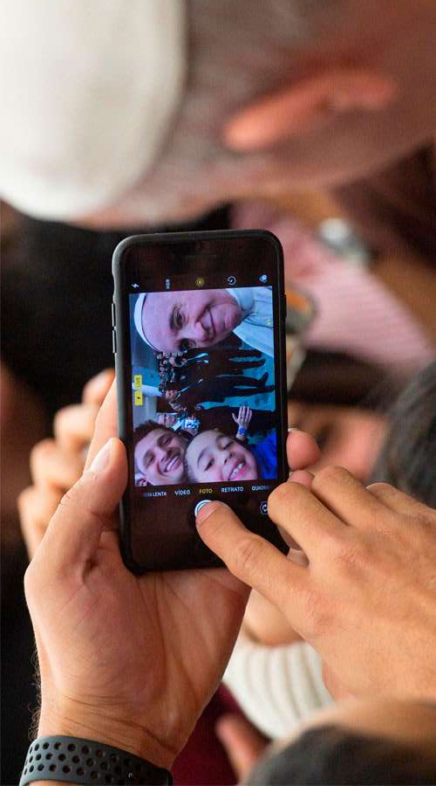
Old and young, we need each other!
During the Synod, one of the young auditors from the Samoan Islands spoke of the Church as a canoe, in which the elderly help to keep on course by judging the position of the stars, while the young keep rowing, imagining what waits for them ahead. Let us steer clear of young people who think that adults represent a meaningless past, and those adults who always think they know how young people should act. Instead, let us all climb aboard the same canoe and together seek a better world, with the constantly renewed momentum of the Holy Spirit. (CV 201)
Notes:
​"Christus Vivit – Christ is Alive" is for all of us, old and young. This letter reminds us that we need each other. Together, old and young, we are finding our way through our night to encounter the love of Christ and the joy of mission. Pope Francis shared a story from the Synod that illustrates our mutuality.

Slide 31


