Slide 1
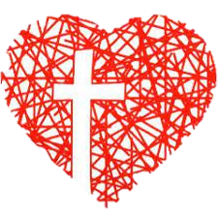
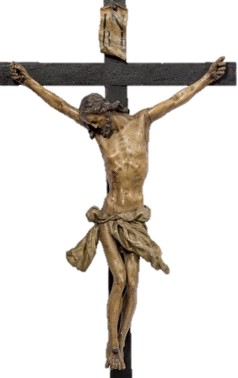
Our way of the Cross at Home
While we reflect on Jesus’ personal journey, through the Stations of the Cross, from Pilate to the tomb, we too are drawn into that story today. And, while he was forced through ancient streets, we are reminded of his saving presence here, now, in our own home.

Slide 2
Items used:
1. Bathroom or kitchen sink 2. A clock, watch or phone-clock 3. The floor
4. Parents, or a picture of them 5. Something someone helped make 6. First aid stuff
7. a place to sit or lie outside 8. Where we eat 9. My bed
10. Washing machine 11. A crucifix 12. Photo of someone who has died
13. Something precious that is broken 14. A candle
Written for Mercy Parish, Dunedin, by Jan and Colin MacLeod - Images were made by the children of St Brigid’s School, Dunedin

Slide 3
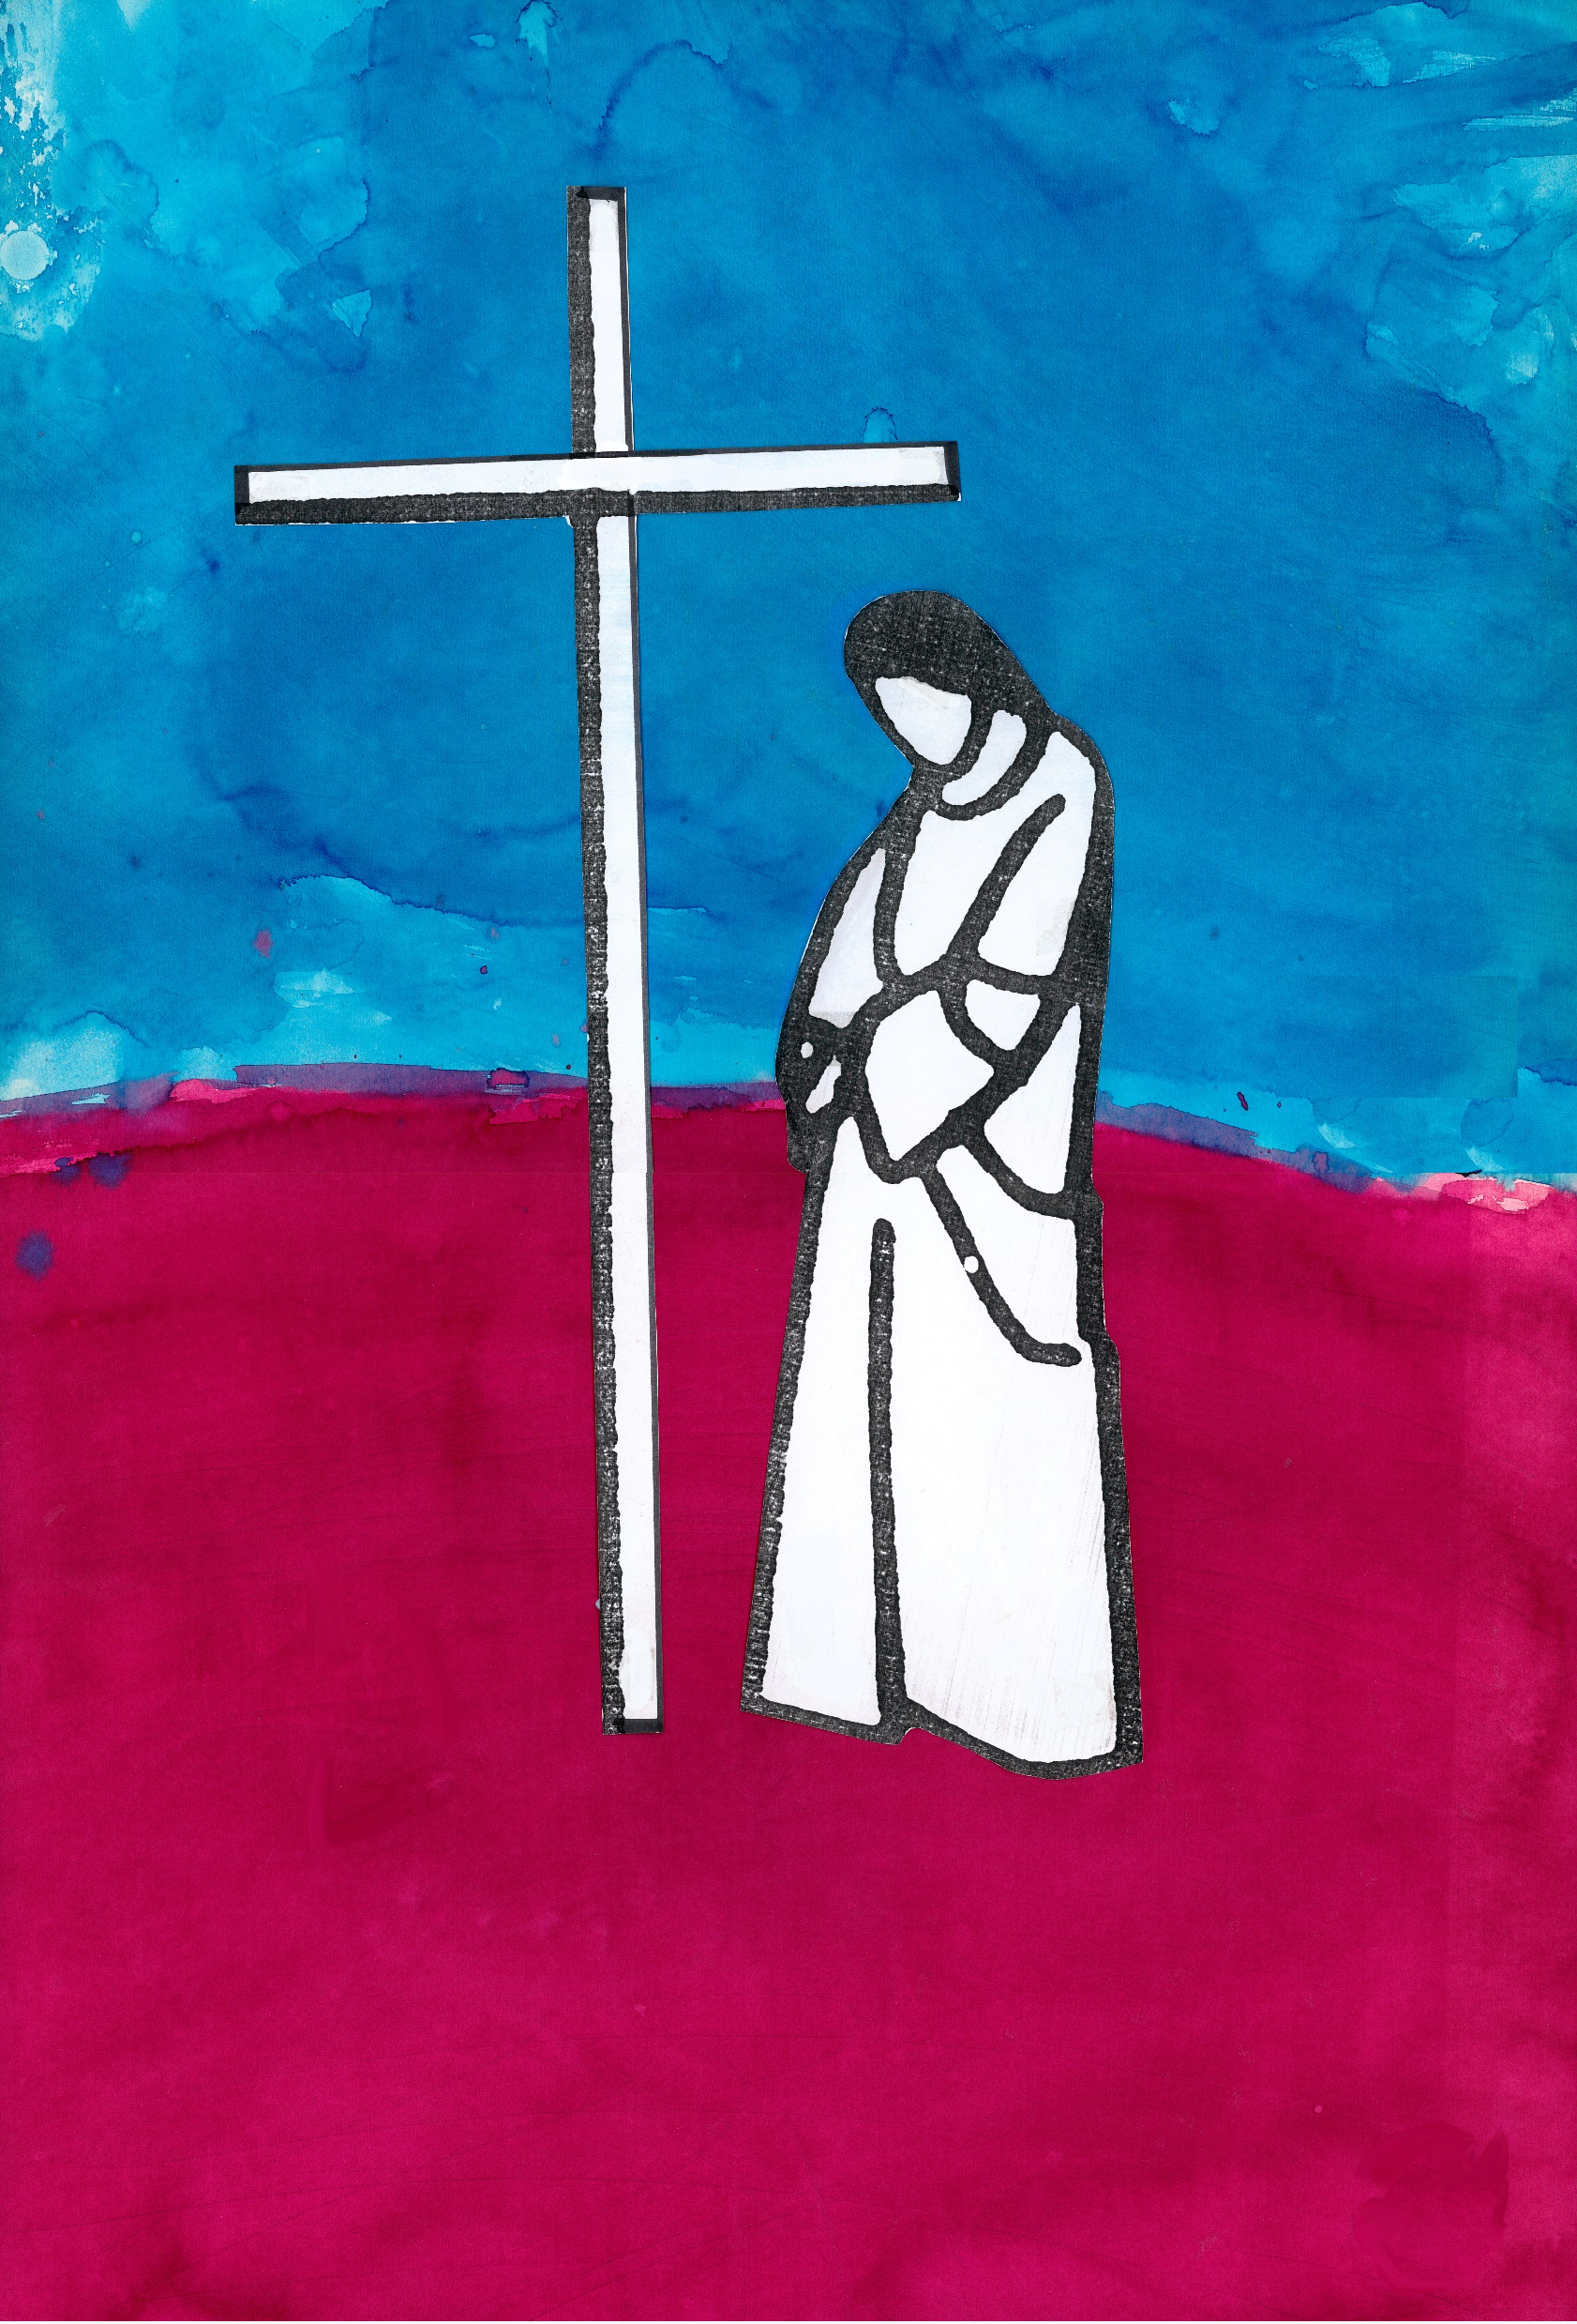
Station 1 – Jesus is Condemned
At the bathroom or kitchen sink.
Jesus, you are wrongly arrested and dragged before a powerful man who judges you without really listening or understanding who you are. He washes his hands with water and says, “I am innocent of this man’s blood.”
I wash my hands and bring to mind a memory of when I know I have not listened, when I chose not to understand, when I simply did not care. And I am sorry.
Loving Jesus, give me your strength not to judge others, but to open my heart with aroha love.
We adore you, O Christ, and we bless you. Because by your holy cross you have redeemed the world.

Slide 4
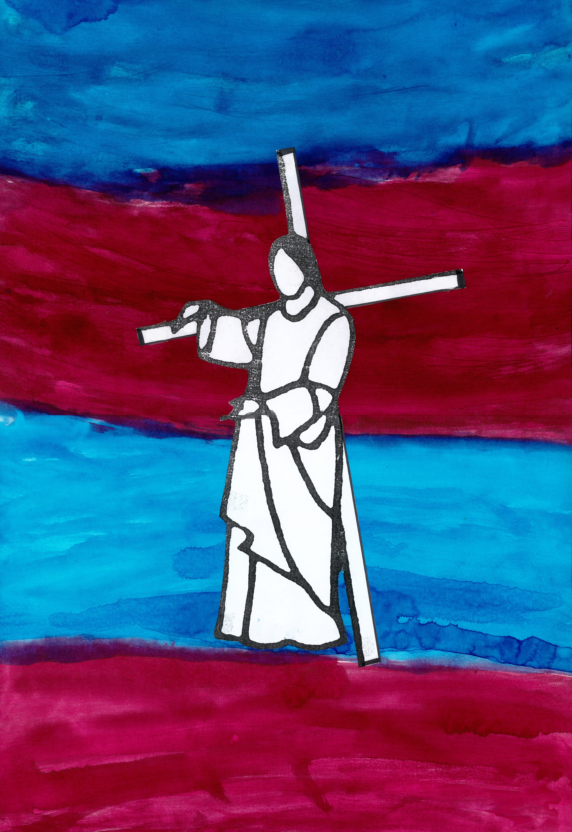
Station 2 – Jesus Takes His Cross
Looking at a clock
Jesus, you are forced to carry the wood of the cross, this heavy weight on which you will be brought to death. It is cruel, and deeply unfair. You take it up with love, because you make the choice to be true to yourself, to never waiver in your love for me.
I think of the time we give to one another and bring to mind the long hours and difficult tasks I have undertaken with love, even though I may have had little choice, or it seemed unfair.
Loving Jesus, give me your courage when I must take up my little cross compared to yours, and remind me that you carry it with me.
We adore you, O Christ, and we bless you. Because by your holy cross you have redeemed the world.

Slide 5
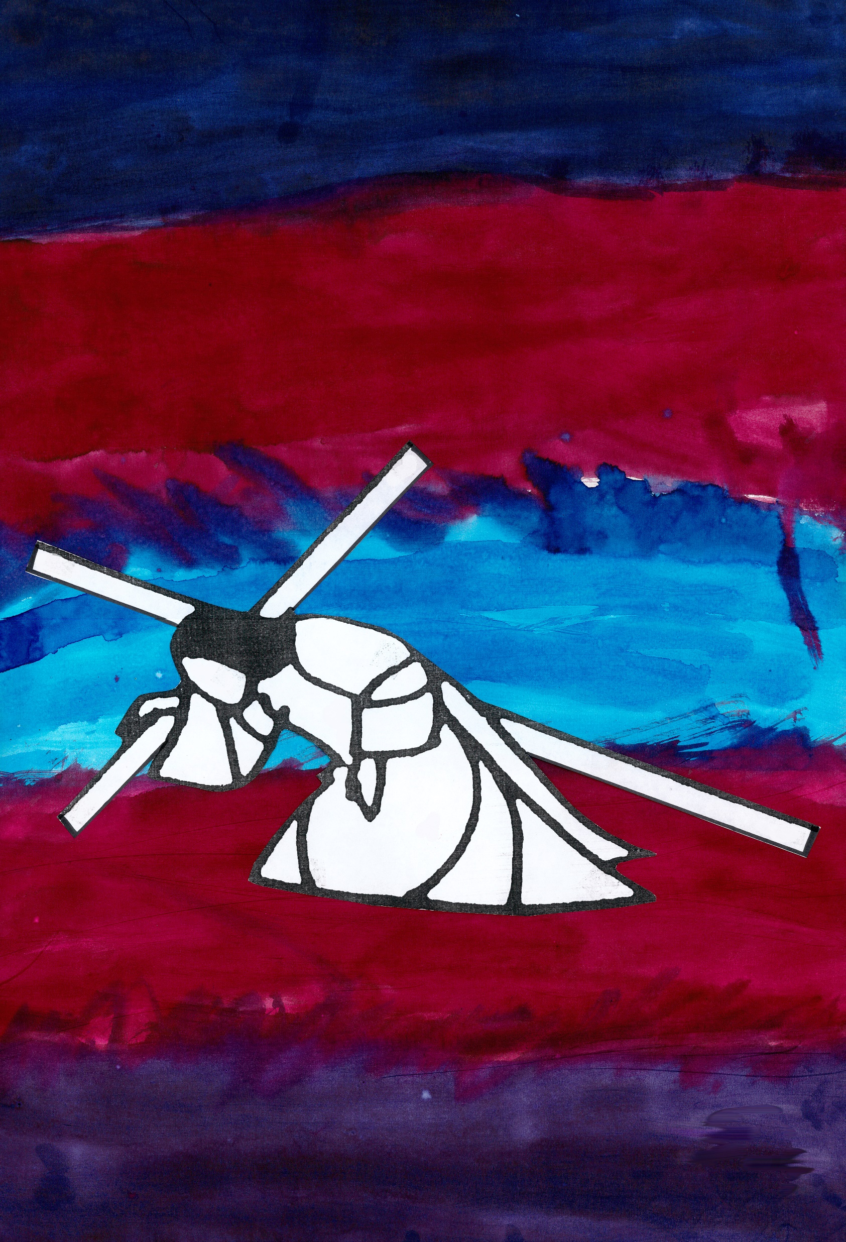
Station 3 – Jesus Falls the First Time
Lying or sitting on the floor
Jesus, you fall to the ground with the weight of the wood on your back. You, who in these same streets lifted others up, healed and forgave, are brought physically low. With others all around, you lie alone in the dust and the dirt.
I feel the floor of this room beneath me, I see a-new this place where I move, work and love every day. I recognise the gift of my freedom, especially to serve others and receive from them in this home.
Loving Jesus, when I fall help me to see the world in a new way, so that when I get up again I may view my life through your eyes.
We adore you, O Christ, and we bless you. Because by your holy cross you have redeemed the world.

Slide 6
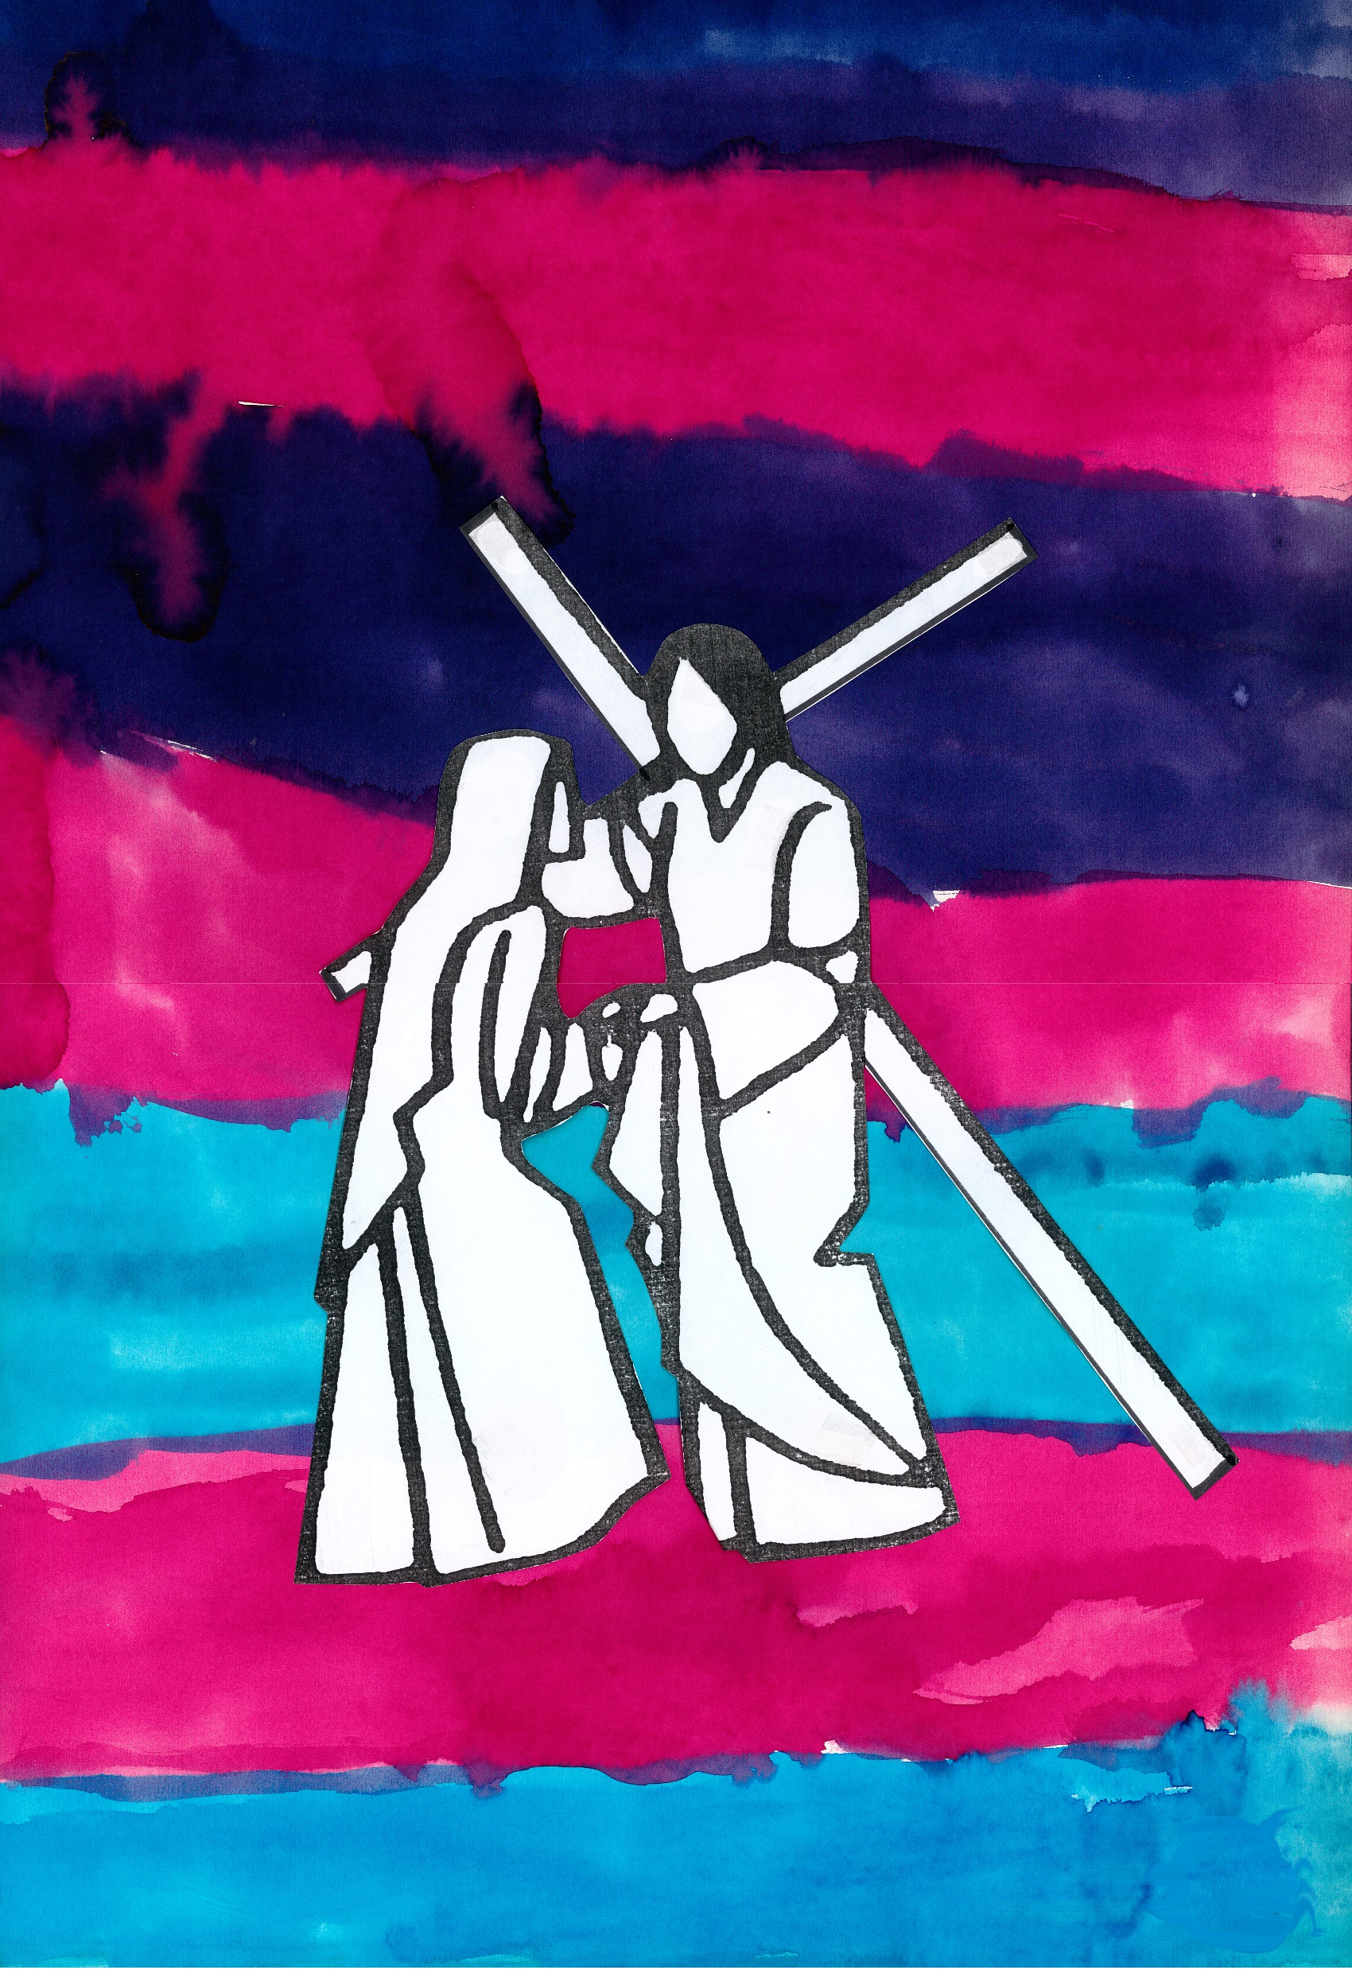
Station 4 – Jesus Meets His Mother
With a picture of my parents (or actually being with them)
Jesus, on this terrible road your Mum waits for you with a parent’s eternal love. Her eyes, which first looked on you in Bethlehem, meet yours with tears and pain. There is no time for all the words which could be said. She is your mother; you are her child.
I give thanks for my parents and bring to mind a memory where they reached out in love when I was in trouble or pain.
Loving Jesus, I give thanks for the blessings my parents have given to my life, I am sorry for any pain I may have caused them, and I ask for your help to be the best child I can be.
We adore you, O Christ, and we bless you. Because by your holy cross you have redeemed the world.

Slide 7
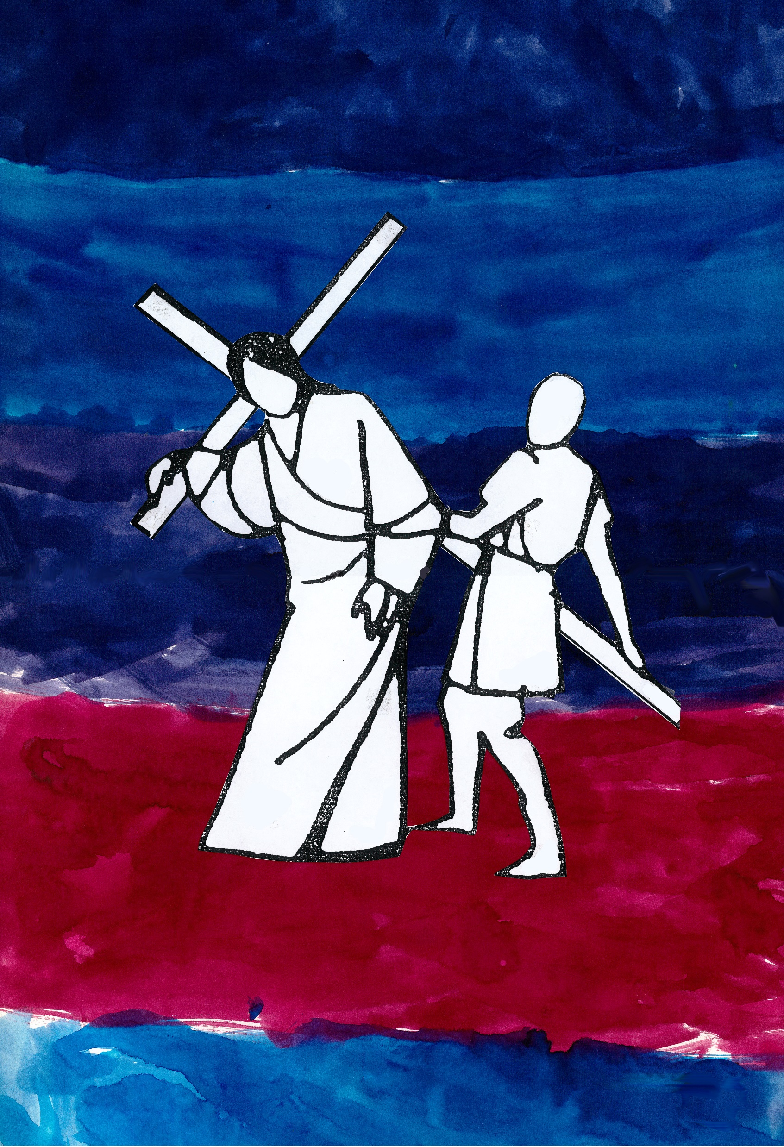
Station 5 – Simon Helps Jesus
At a place, or with an item, that someone has helped make
Jesus, you cannot carry the weight alone. It is too much, and the soldiers make Simon help you because they know your strength is nearly gone. I struggle to imagine what his help may mean to you – or to him.
I acknowledge the help of others. I bring to mind one thing that I did not do alone and give thanks for the gift it brought to me – and to the helper.
Loving Jesus, give me wisdom and courage to step out of the shadows to help when I am needed.
We adore you, O Christ, and we bless you. Because by your holy cross you have redeemed the world.

Slide 8
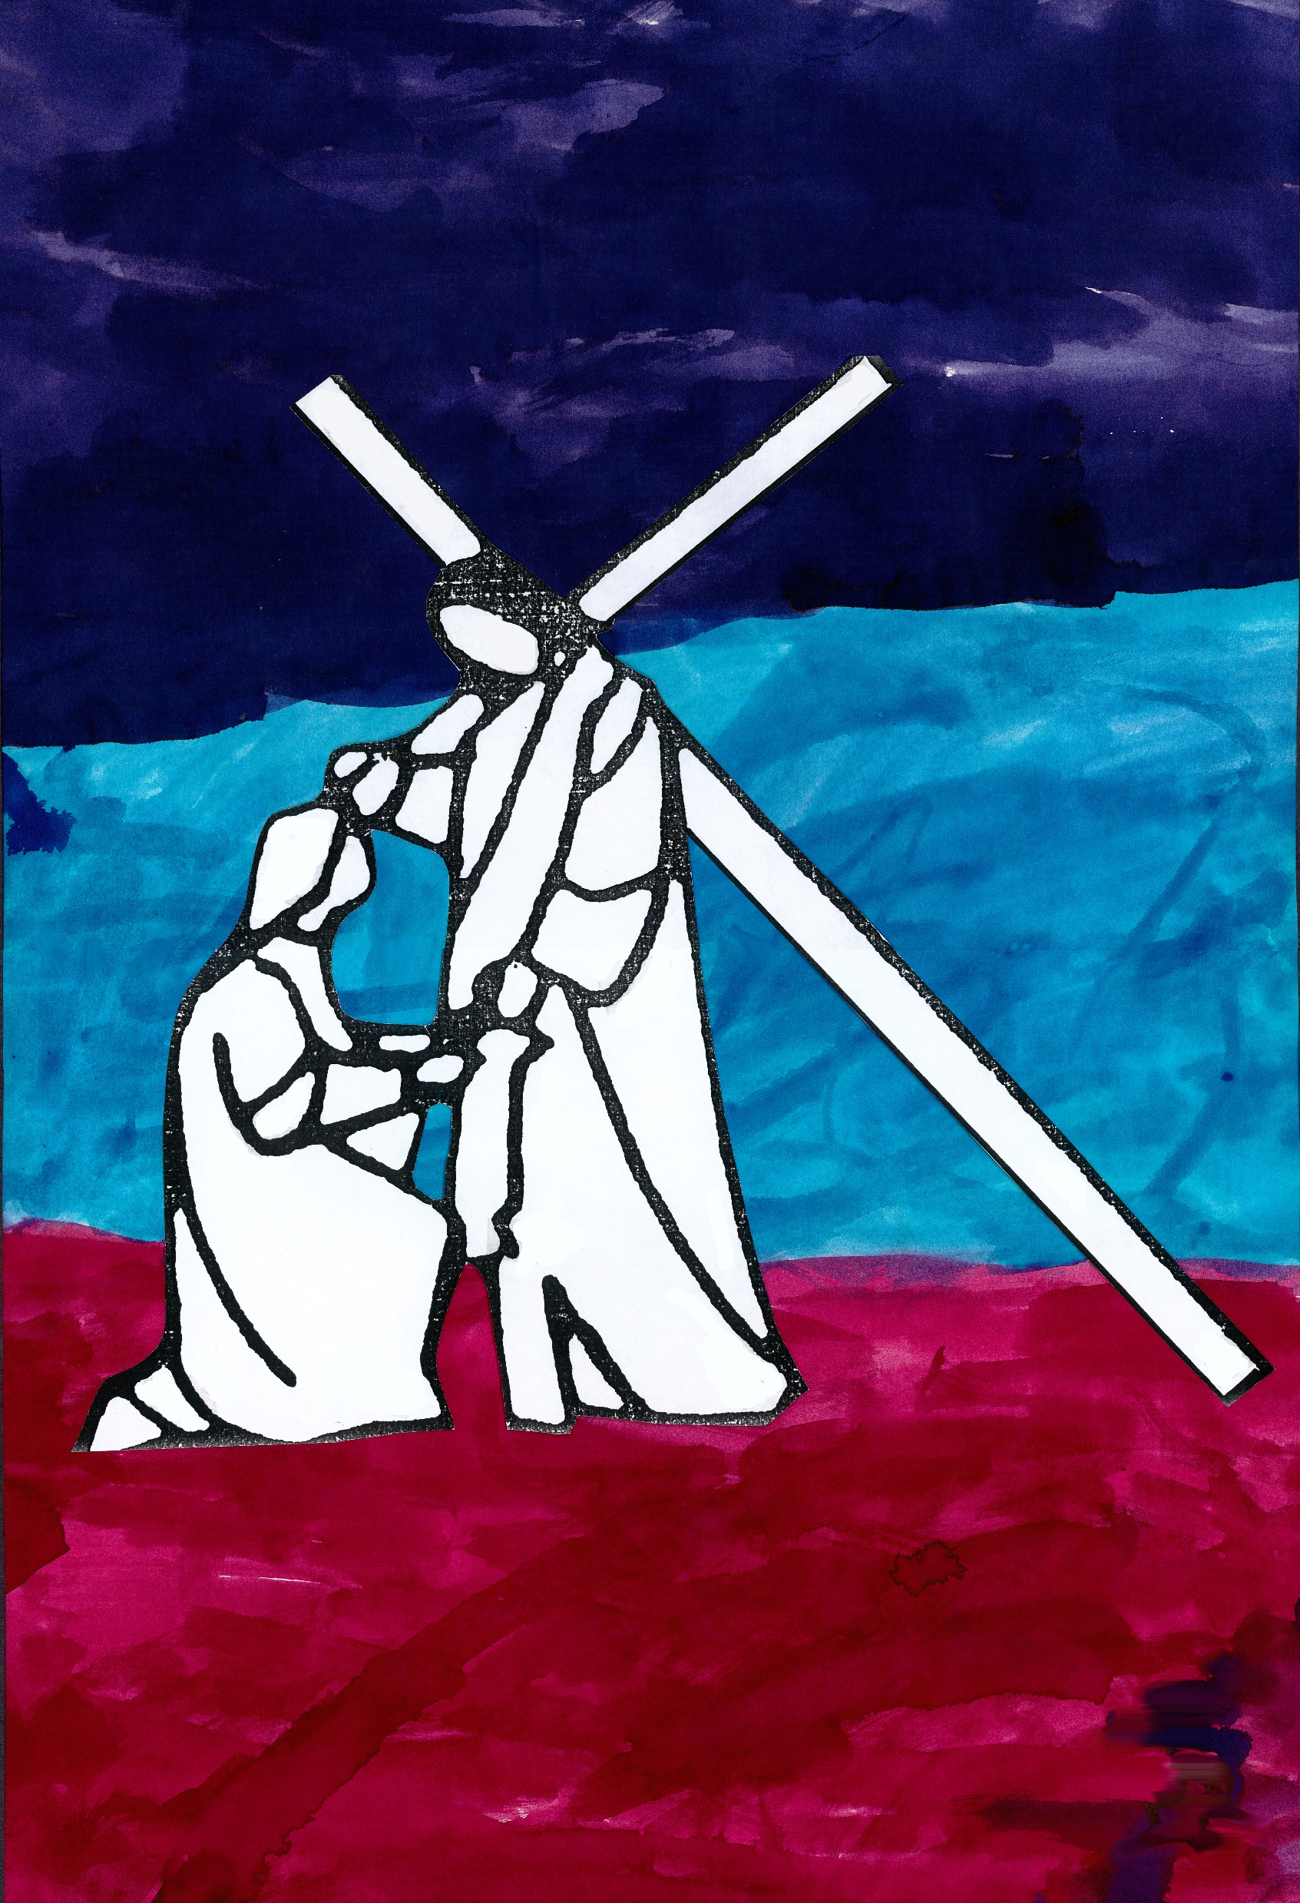
Station 6 – Veronica Helps Jesus
With our First Aid Stuff
Jesus, you are beaten, sore and bleeding. In the ancient story of Veronica wiping your face we see the hands of another reaching out to acknowledge and ease your physical pain, and we see your face in her act of compassion.
I am fragile. We clean and bandage physical wounds, and with words and actions we help heal wounds that go deeper than skin and bone. Now I bring to mind a memory of when I have been part of another’s healing.
Loving Jesus, your face is present in every act of compassion, help me to see you in the love I give and receive.
We adore you, O Christ, and we bless you. Because by your holy cross you have redeemed the world.

Slide 9
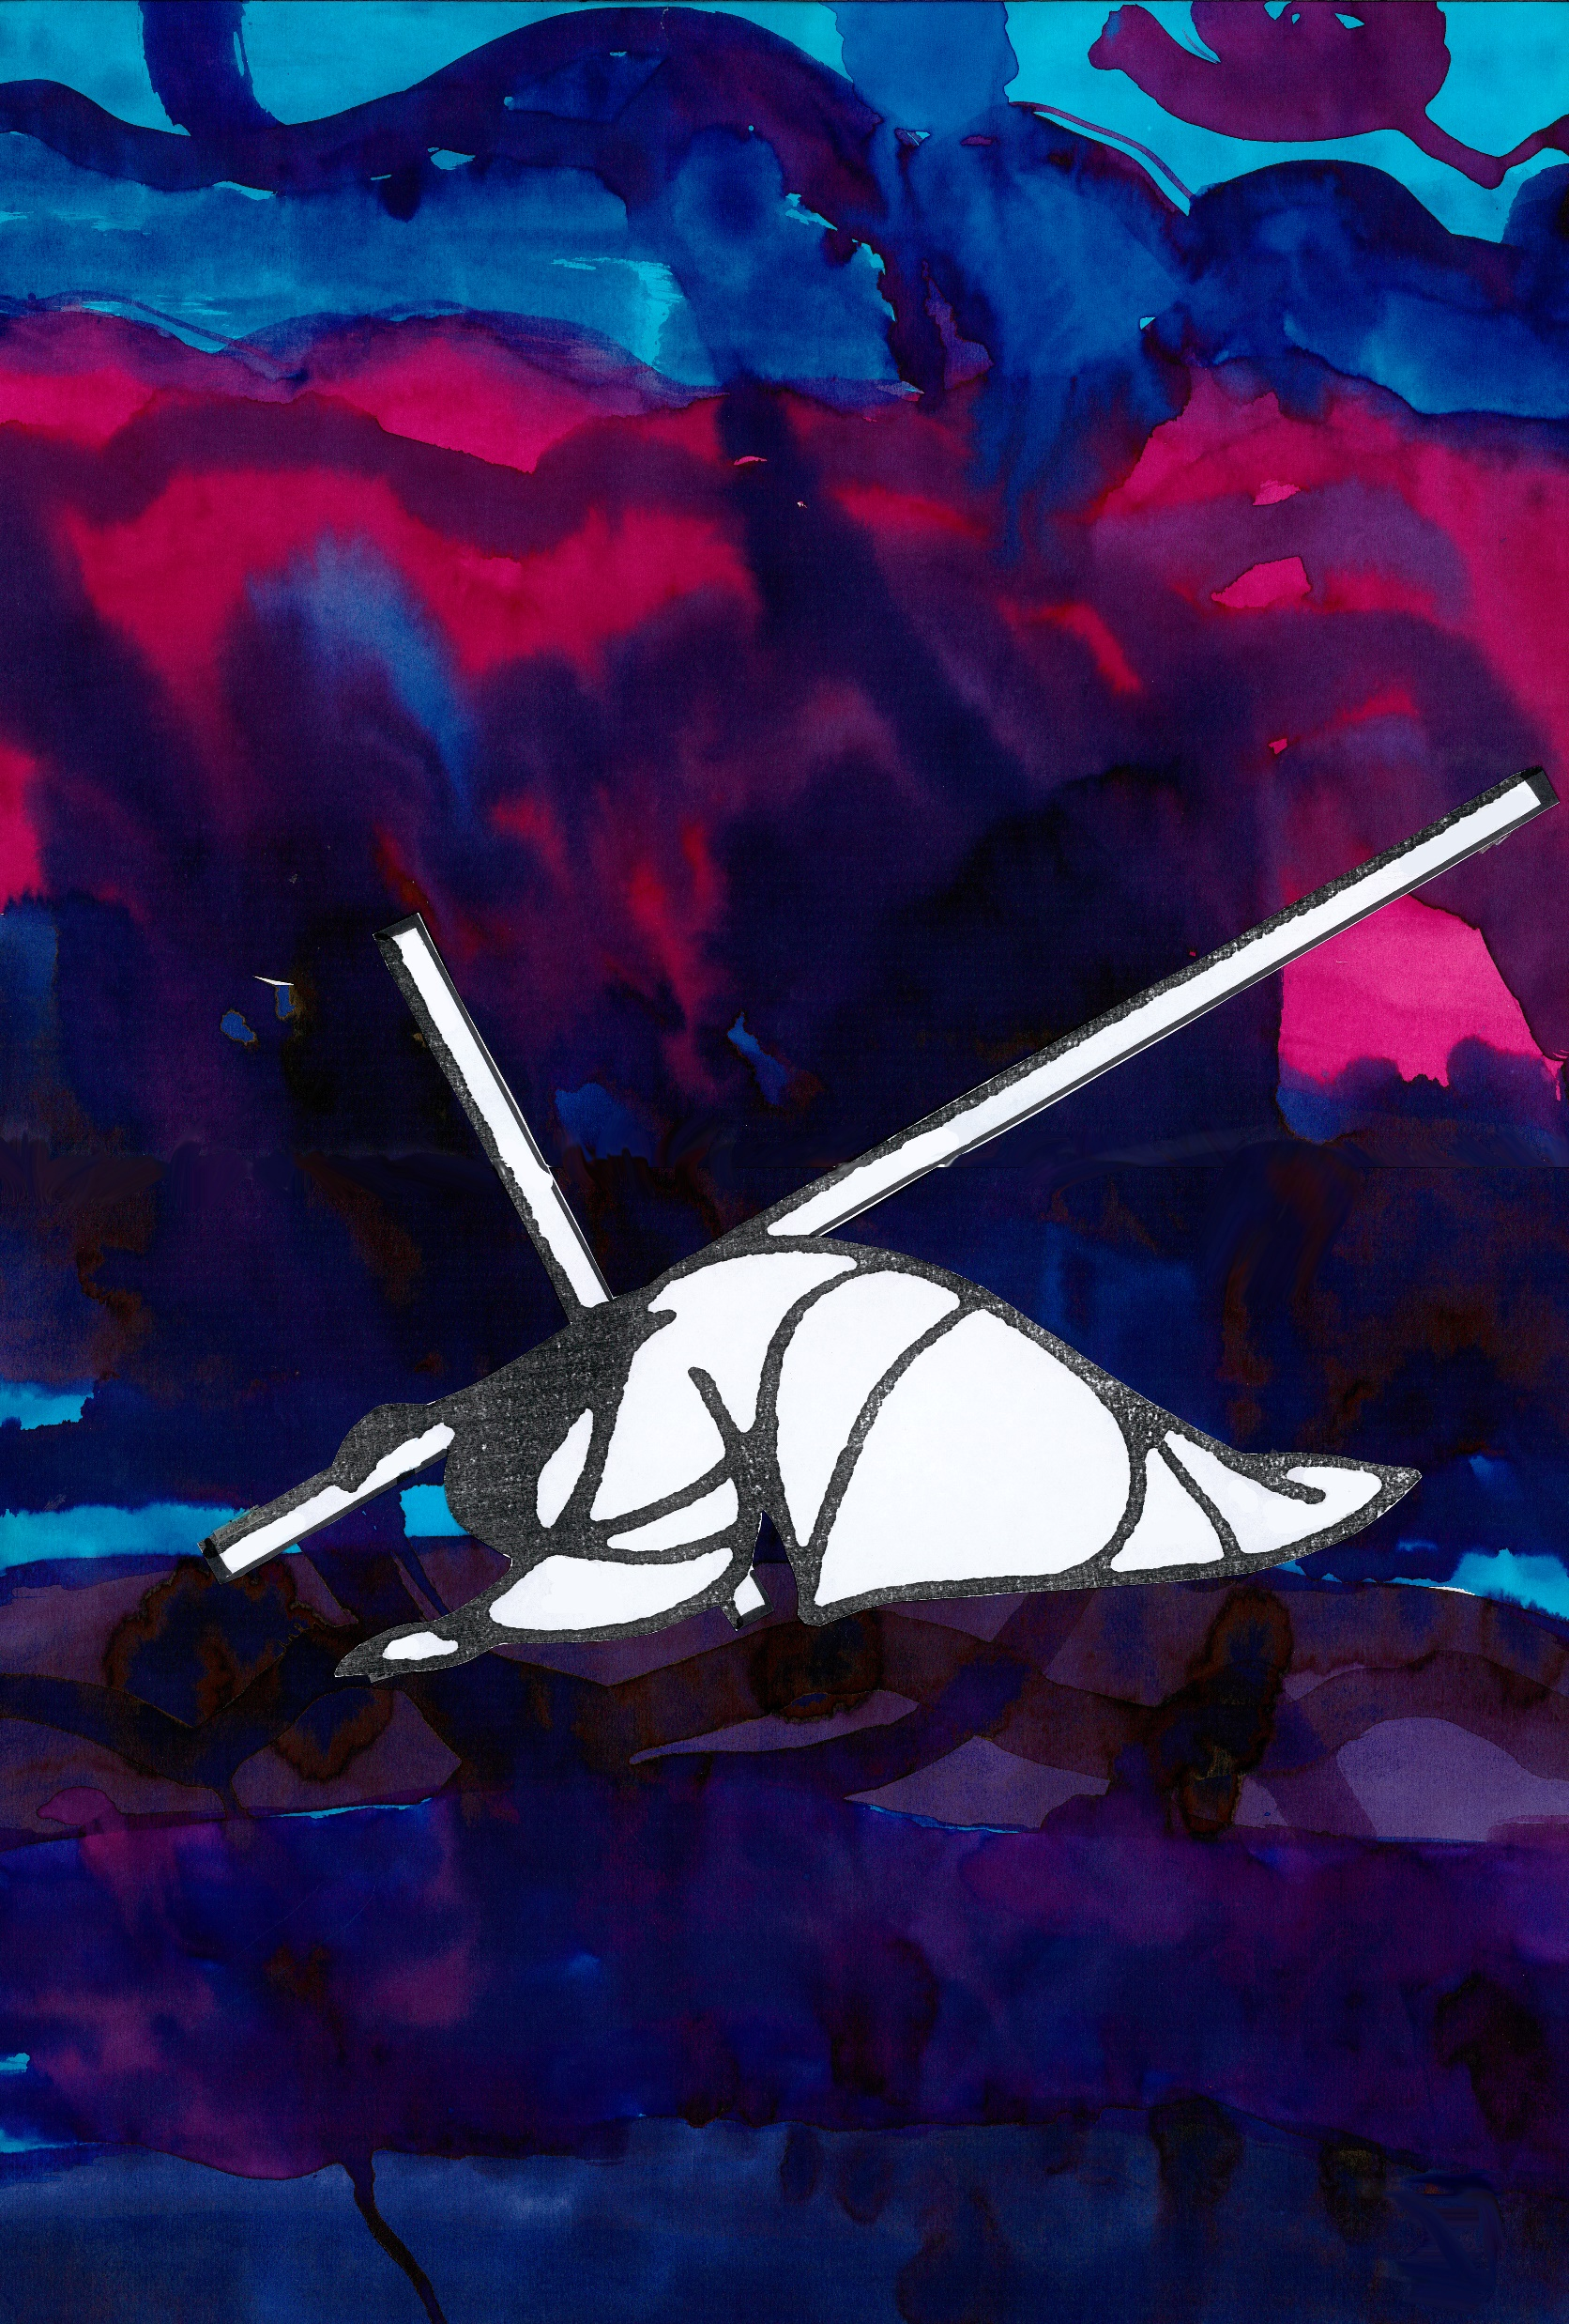
Station 7 – Jesus Falls Again
Sitting, or lying, outside
Jesus, surrounded by familiar weather and sound and scent, your strength is drained from you, and even with Simon’s help it is impossible to stay on your feet. You collapse to the ground, again, and at the harsh insistence of soldiers, you immediately must struggle to get up.
I take note of the ordinariness of being outside, of the gift of this world – the air, the light, the sound, the smell, the touch.
Loving Jesus, help me to love this world. When choices are difficult or confusing help me to stand with thanks and to do what I can.
We adore you, O Christ, and we bless you. Because by your holy cross you have redeemed the world.

Slide 10
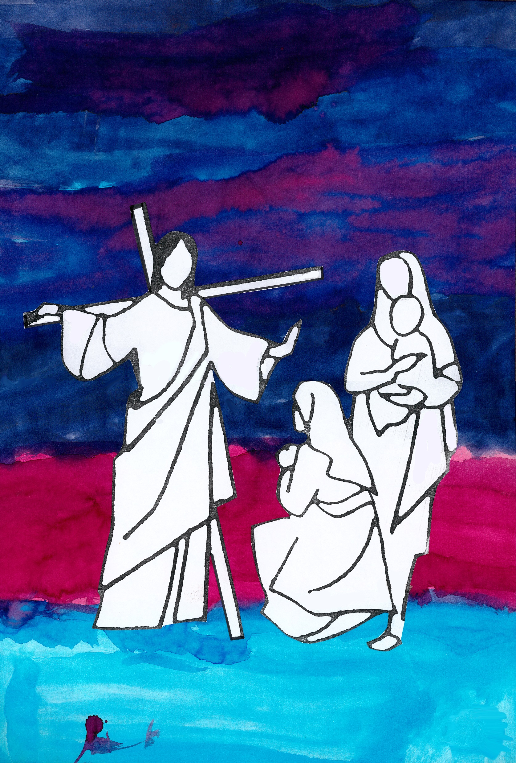
Station 8 – Jesus Comforts the Women
At a place where we eat dinner
Jesus, on this terrible journey you meet women who you have known in sharing a meal, conversation or prayer. Even in your deepest anguish you acknowledge the compassion of their grief, and their gift as mothers, daughters and sisters.
I take a moment to give thanks for my wider whānau family. I bring to mind someone with whom I feel especially connected and I give thanks for that person in my life - for the opportunity to ‘break bread’ with them.
Loving Jesus, comfort me when I feel alone, remind me of those who love me, and open my heart to their love.
We adore you, O Christ, and we bless you. Because by your holy cross you have redeemed the world.

Slide 11
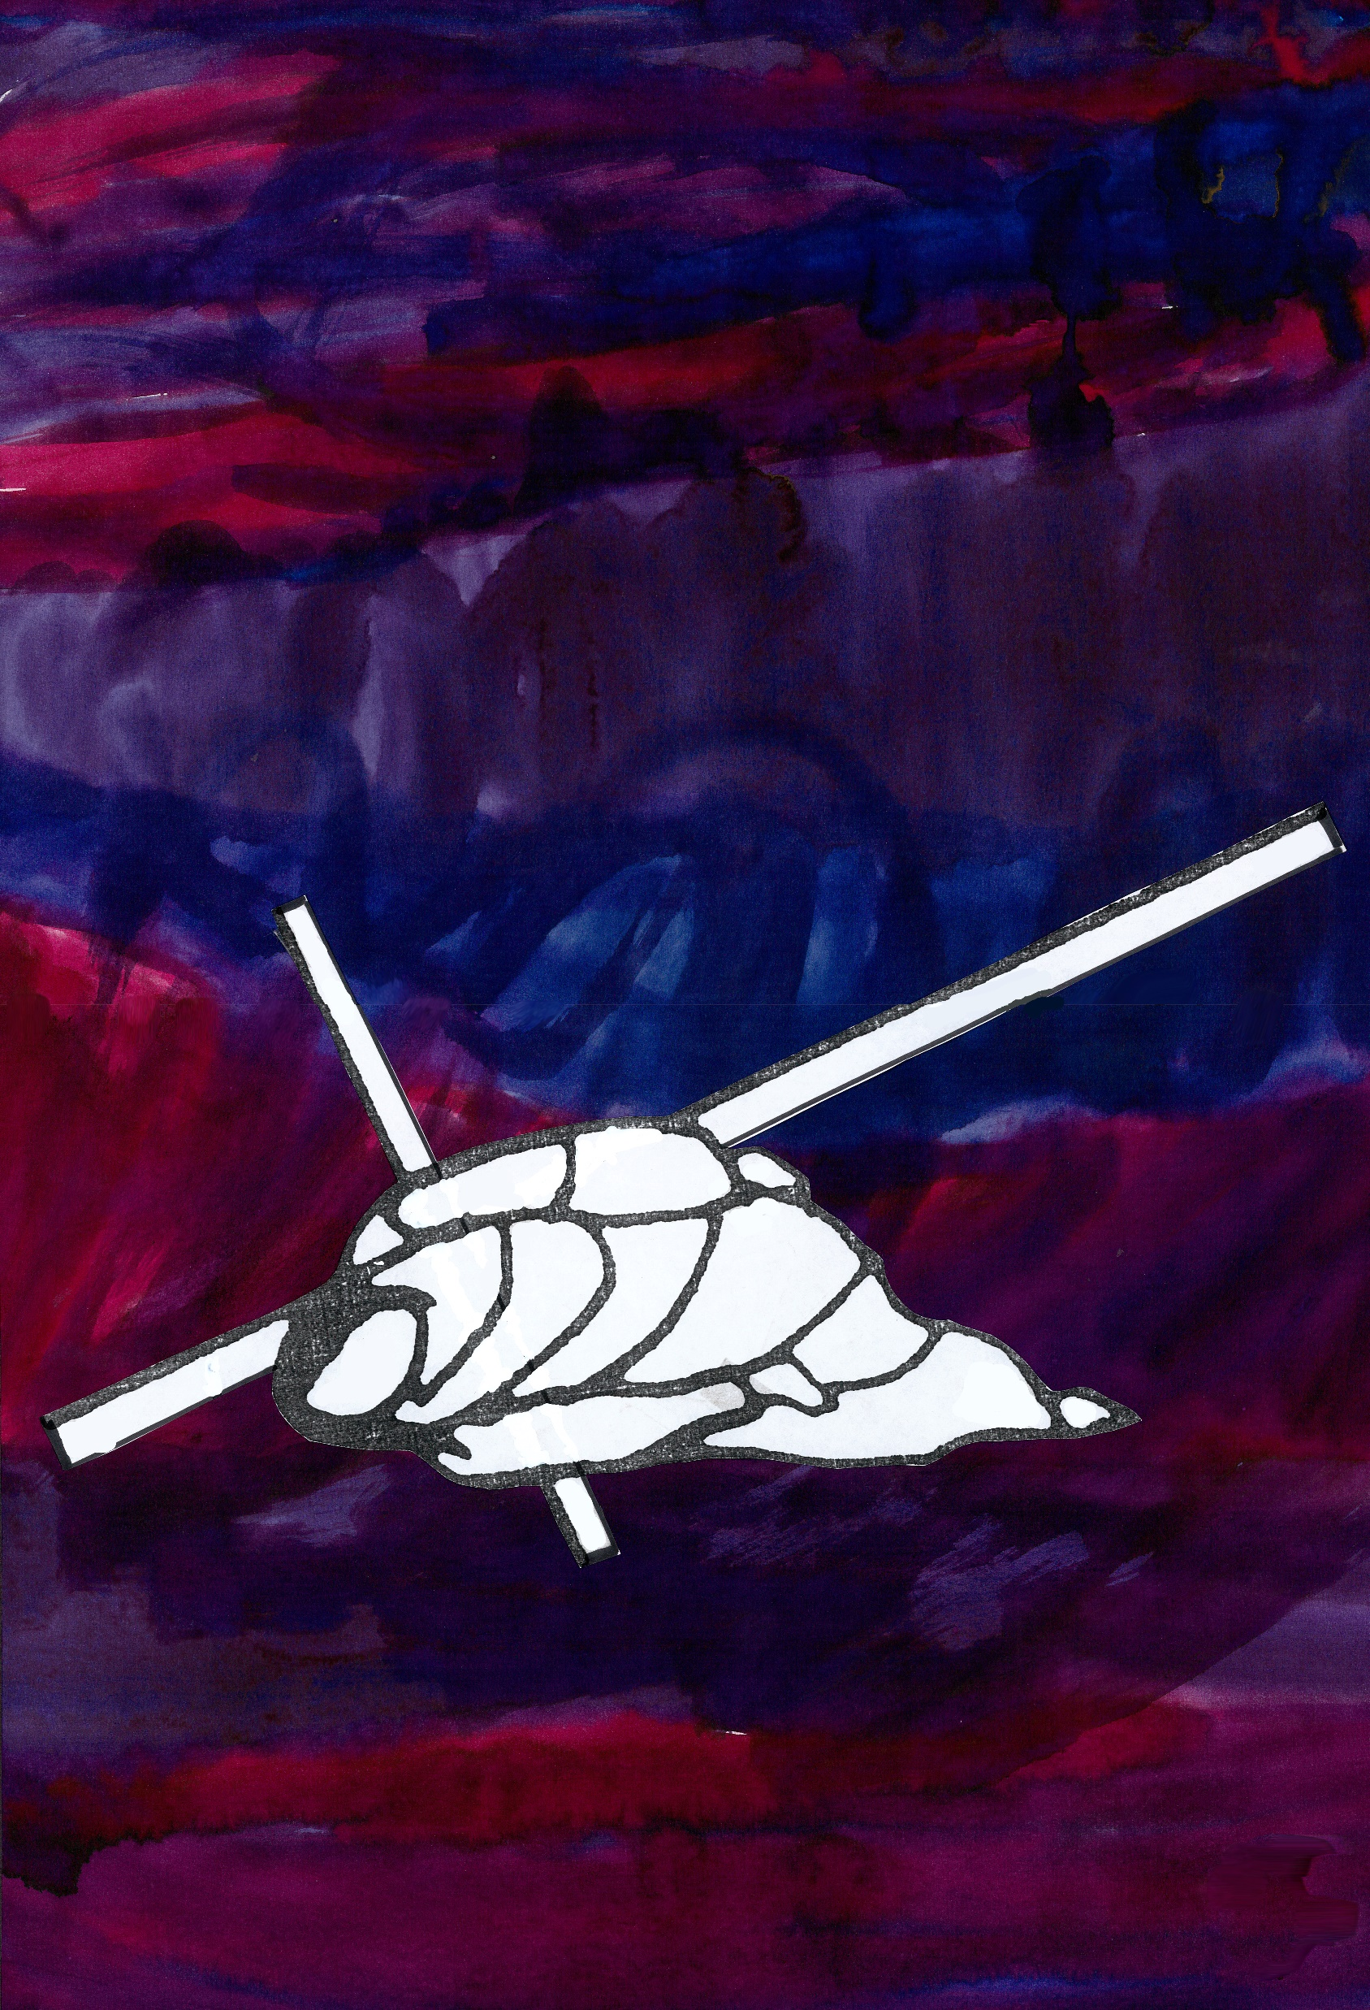
Station 9 – Jesus Falls the Third Time
At my bed
Jesus, you fall a third time. Exhausted, bruised, thirsty and abandoned, there is no-one to break your fall. It is impossible to believe you will be able to get up.
I bring to mind a memory of being so sick, or tired, I thought I would never be able to get out of bed. I remember my thoughts at the time, the words of care spoken to me, and I remember the return of strength in body or in mind.
Loving Jesus, though I think you could not see it during this fall, give me your courage to look beyond the difficulties of today and to fix my gaze on a shared hope of tomorrow.
We adore you, O Christ, and we bless you. Because by your holy cross you have redeemed the world.

Slide 12
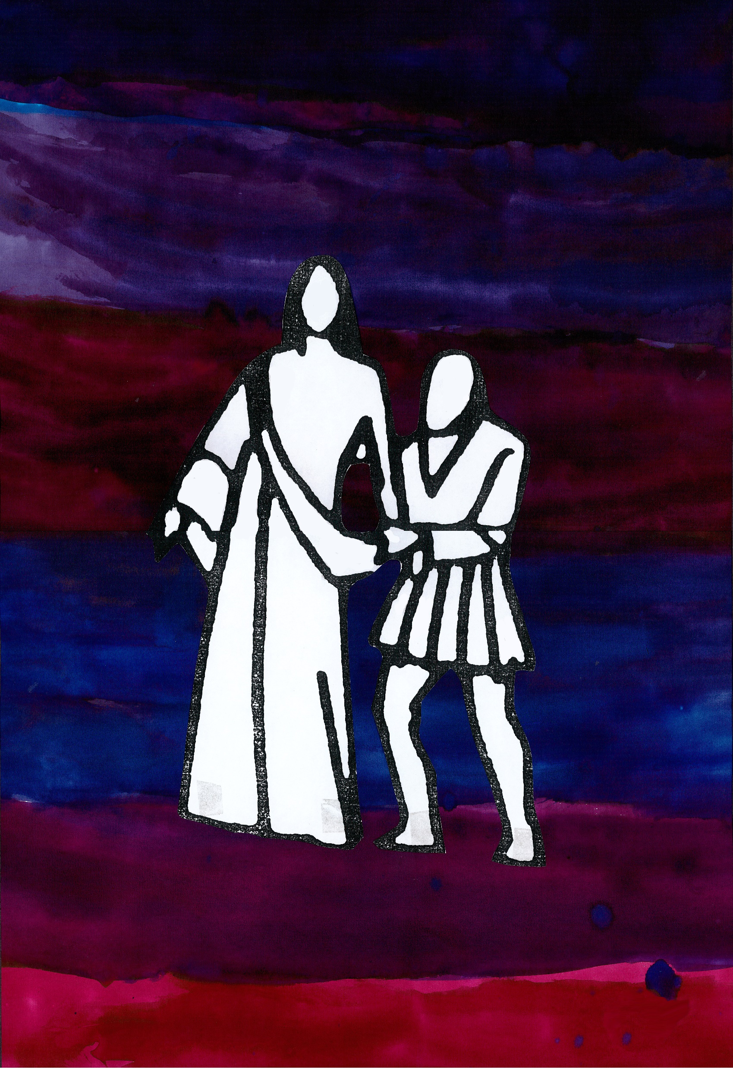
Station 10 – Jesus is Stripped
At the clothes washing machine, or laundry basket.
Jesus, your clothes are taken, and you become naked before the cross and those who are watching. They believe they can take your dignity, not realising that the clothing of your love for us gives you a dignity that covers the world.
I think of my body in the world. I give thanks for the clothes I have, and the ability to be clean. I acknowledge God’s gift of my physical self and bring to mind something I love about my body.
Loving Jesus, you walked among us as a human person, feeling what we feel, remind us that you know what it is to have a body and to live fully in this world.
We adore you, O Christ, and we bless you. Because by your holy cross you have redeemed the world.

Slide 13
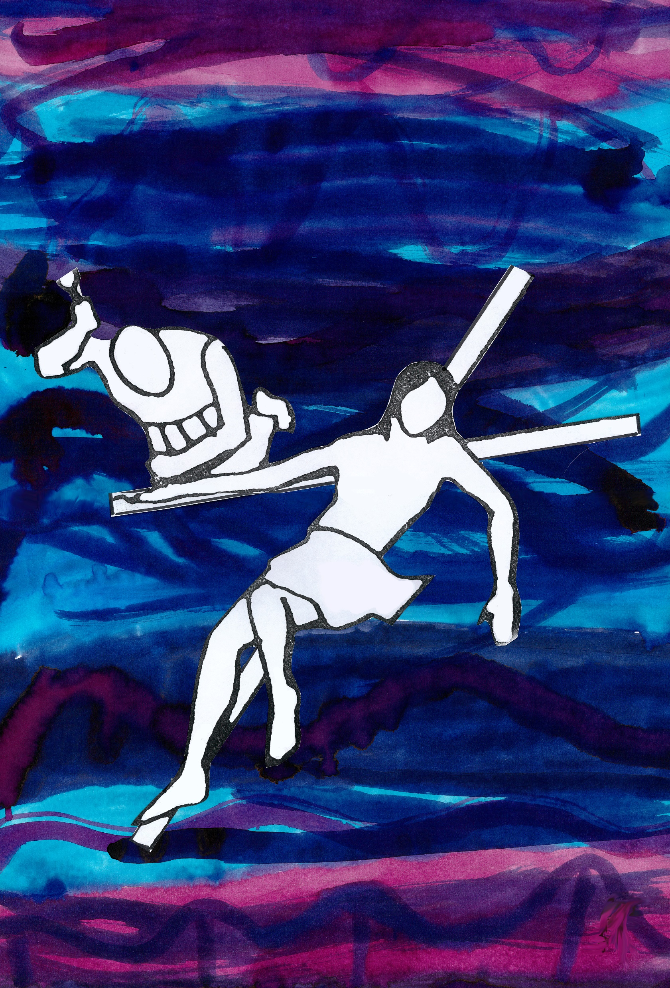
Station 11 – Jesus is Crucified
Standing or kneeling at a crucifix
Jesus, you are nailed to a cross and presented to the world as broken and finished. You, the prince of peace, are made victim to rejection, hatred and violence.
I gaze on the symbol of the crucified Christ and recognise in him all who have been beaten and abused. And I see in him, unbelievably, love for those who are bringers of violence, that they too may be made whole and live lives of reconciliation, gentleness and goodness.
Loving Jesus, you who experienced the worst of humanity, give me your hope and your love to be a person of justice and peace.
We adore you, O Christ, and we bless you. Because by your holy cross you have redeemed the world.

Slide 14
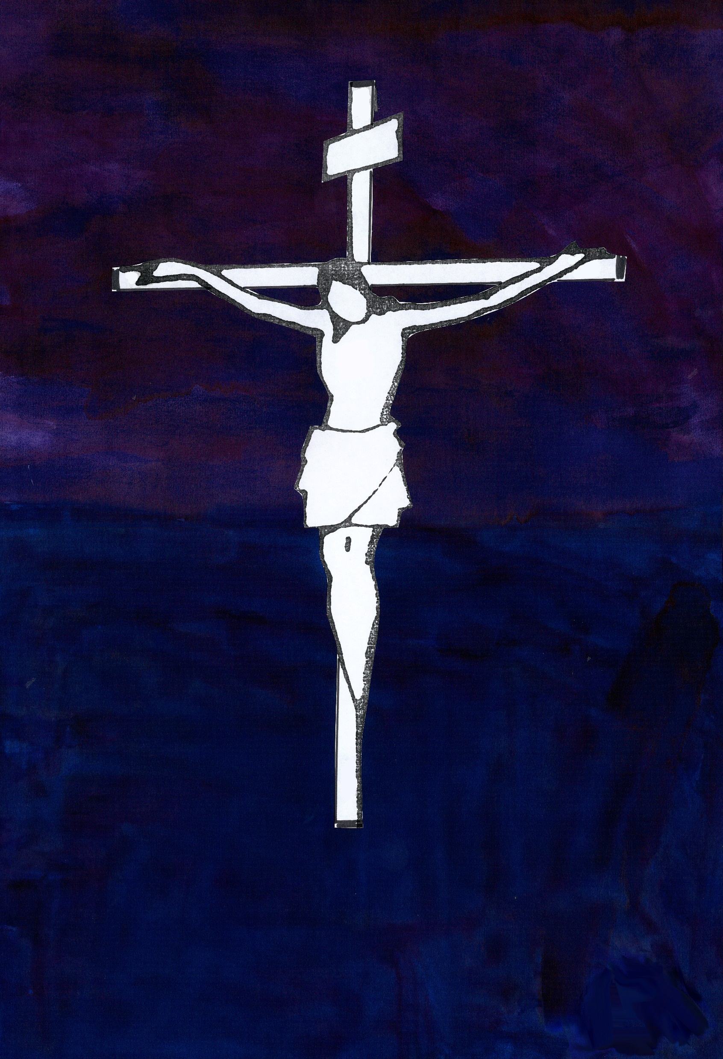
Station 12 – Jesus Dies
With a photo, or other memory, of someone who has died
Jesus, you are dead. There is no doubt. A final cry has sounded from your lips; your final breath has left your body; your heart beats no more. Your friends are gone and so is your life. It is finished.
I take a moment to grieve for those who have died, to feel the loss and let the sadness wash over me again. It is OK. Death and loss are real, and the promise of eternal life we have in Christ is difficult to understand – at his death even Jesus was lost.
Loving Jesus, remind me of your despair as you died, remind me that it is OK to grieve, and to live on in your love.
We adore you, O Christ, and we bless you. Because by your holy cross you have redeemed the world.

Slide 15
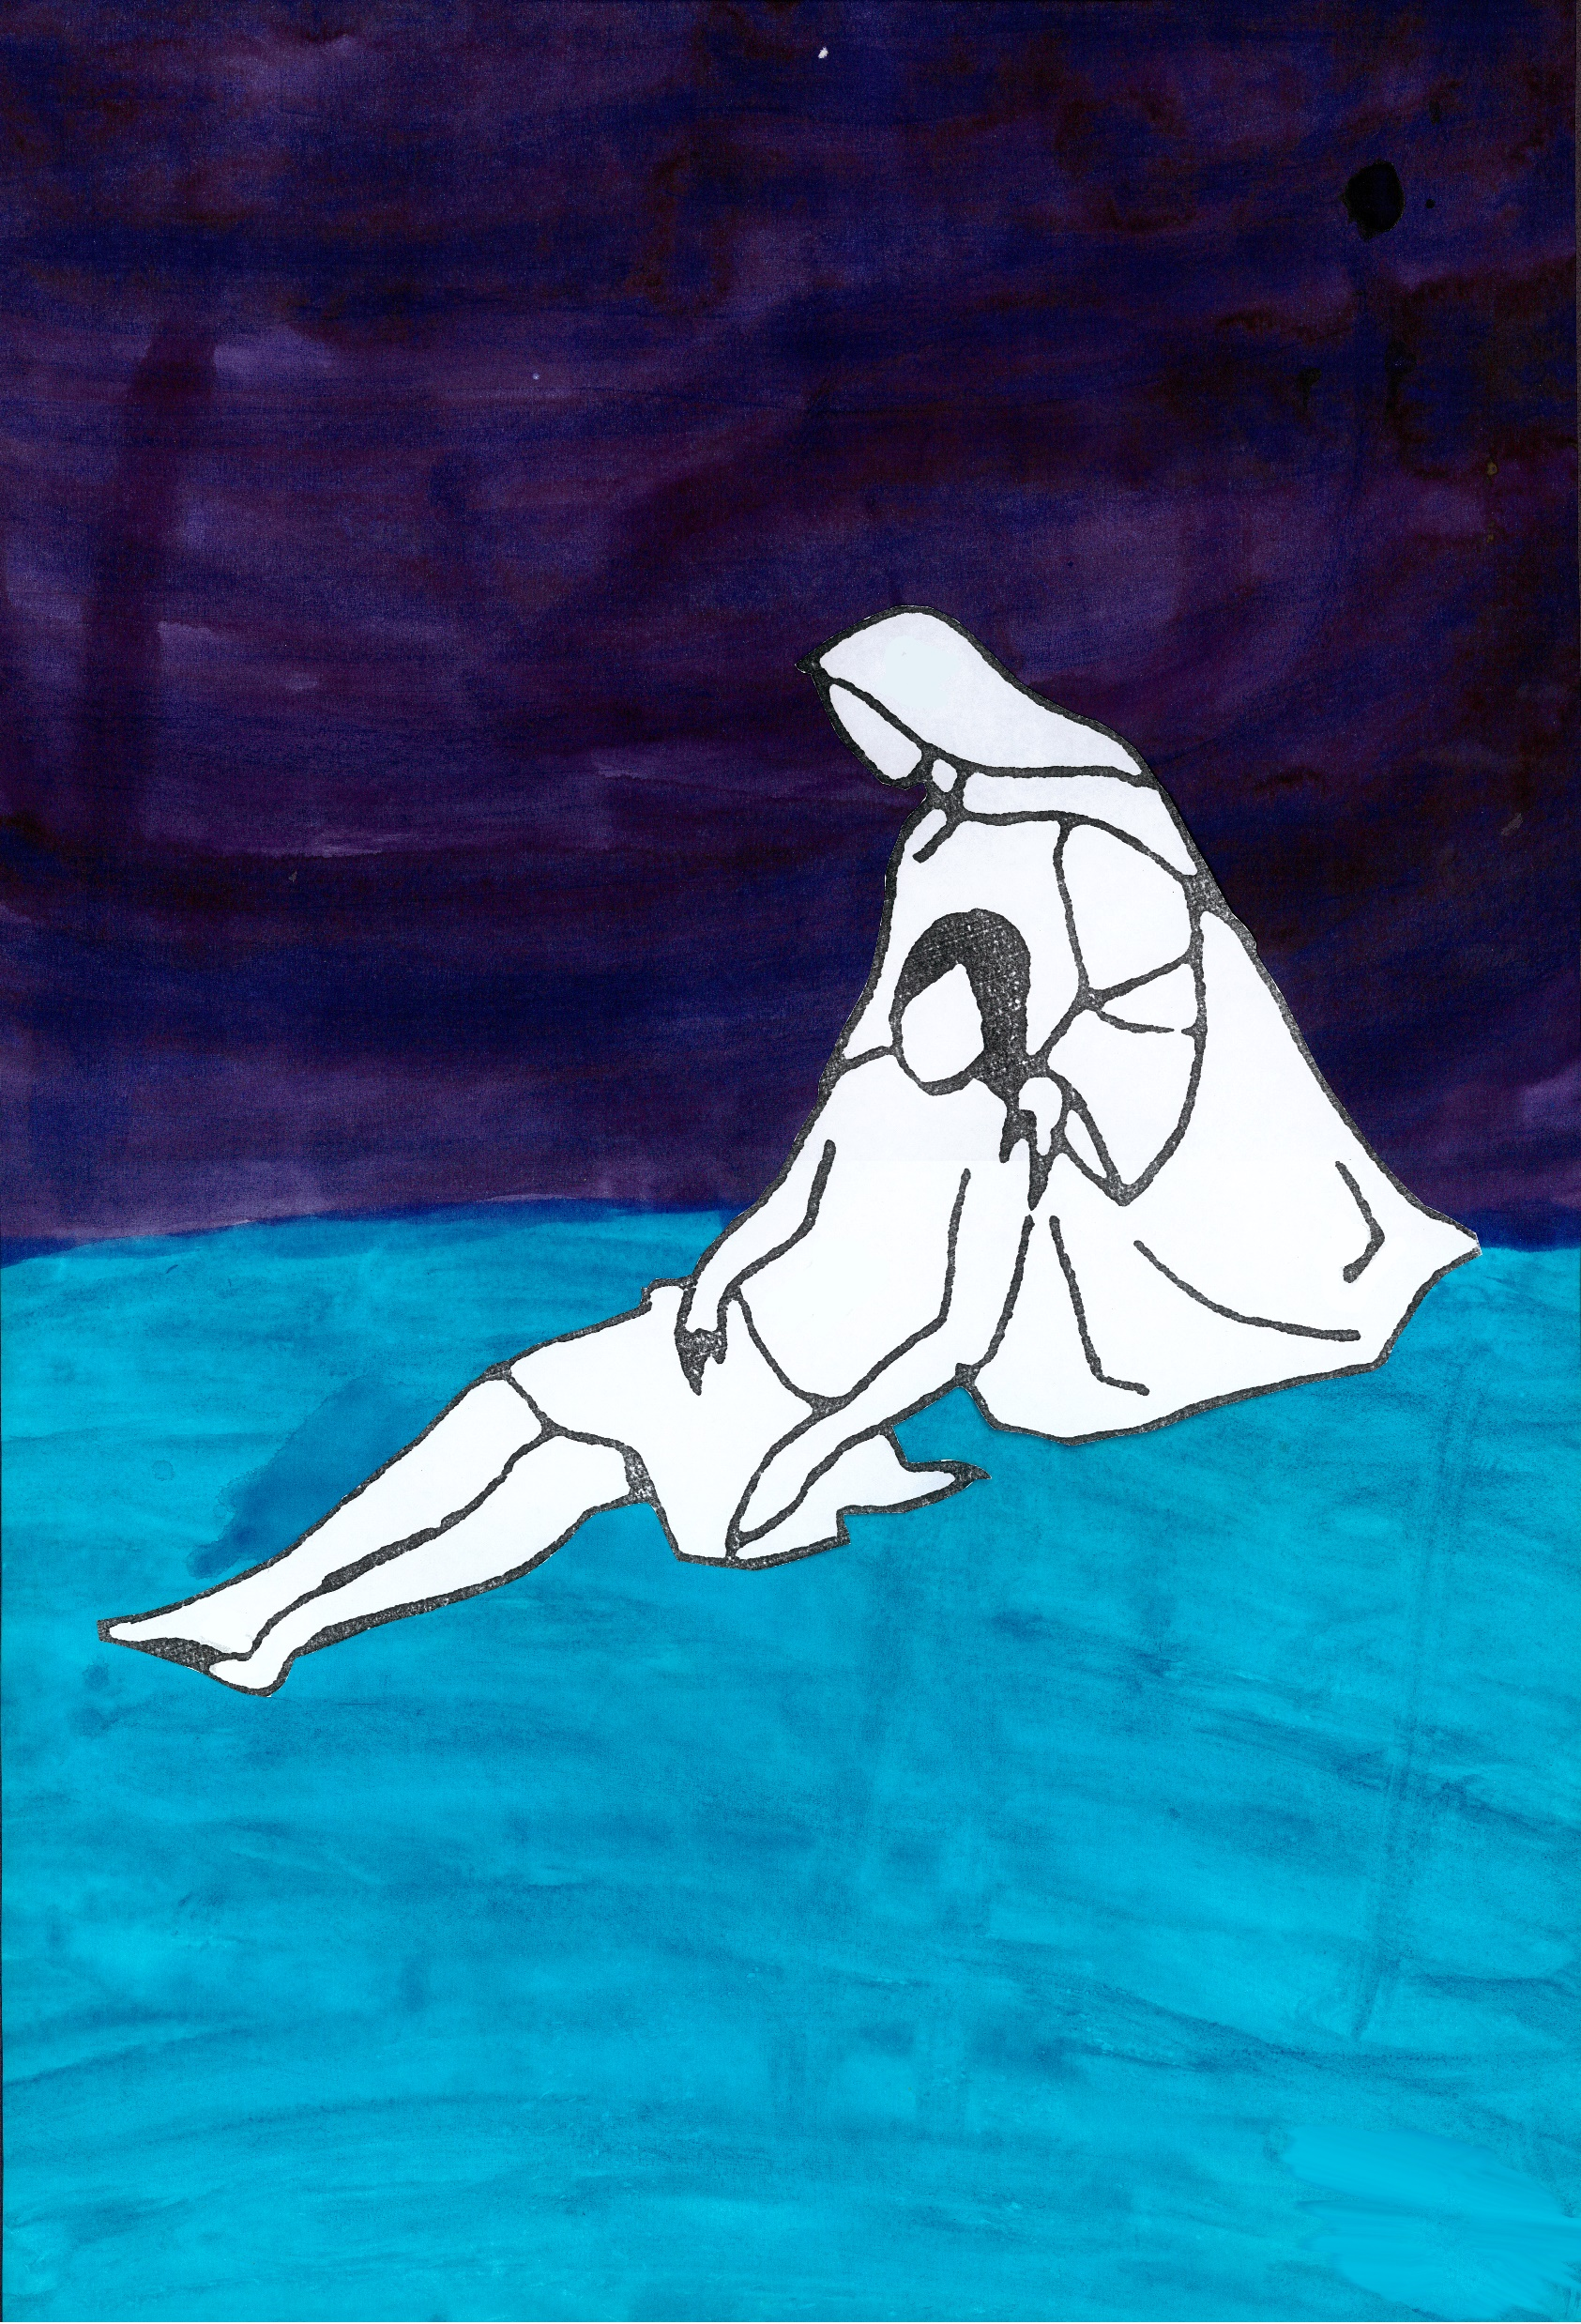
Station 13 – Jesus is Taken Down
With something precious that has been broken or damaged.
Jesus, your lifeless body is removed from the cross and you are placed in your mother’s arms.
I think about what it is to hold something that is now broken, to remember something that is gone. It is not what it was, but the memories it brings to mind link me back to people, places and events – and these remain alive in me.
Loving Jesus, when you feel most absent in my life, when I can’t hear your voice or feel you touch, speak to me through the memories I cherish, touch my heart with the promise of your love.
We adore you, O Christ, and we bless you. Because by your holy cross you have redeemed the world.

Slide 16
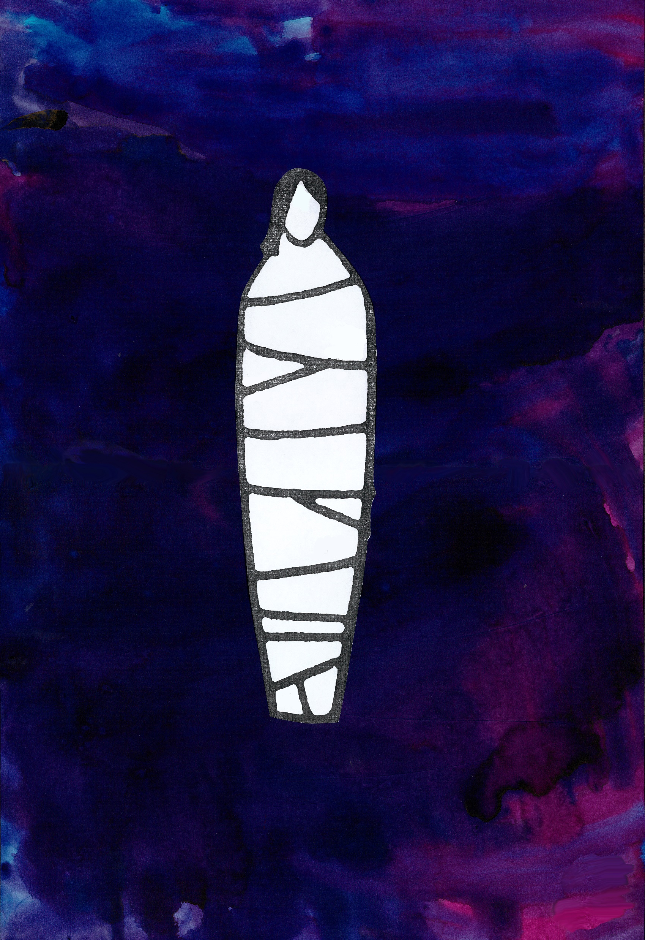
Station 14 – Jesus is Placed in the Tomb
With a candle that is not lit, and a bowl to cover it.
Jesus, your body is placed on rock in a tomb and a stone is rolled across the entrance so that darkness and silence surround you. All is lost. Yet, I tremble with the knowing of what is to come.
A candle is meant to be alight. I look on this candle which is dead, and I entomb it with a bowl. I take a moment to think about what it must have been like to walk away from that tomb without knowing what I know today.
Loving Jesus, I pray for your help when I am in darkness. I ask that especially when I feel swamped by sadness, hopelessness or stress, that I allow the slivers of your light to touch the core of my being and trust in the promise that they will flame into life.
We adore you, O Christ, and we bless you. Because by your holy cross you have redeemed the world.

