Slide 1

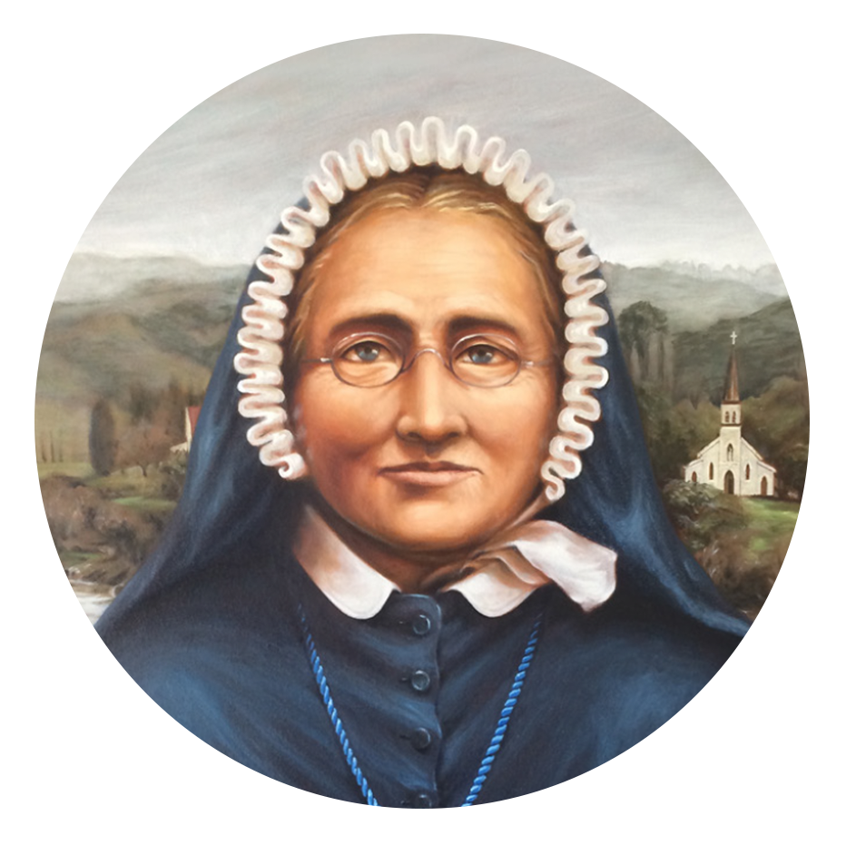

Prayer of the faithful
E te Atua o te Pūaroha - God of Compassion
As we unite in prayer across Aotearoa New Zealand on this Celebration Day, we pray in thanksgiving for the life of Venerable Meri Hōhepa Suzanne Aubert. We pray that her faith, her courage, and compassionate love will live on in us all.
E te Ariki: Whakarongo mai rā ki a mātou

Slide 2
Prayer of the faithful
Te Reo
E te Atua o te Pūaroha
I a mātou e whakakotahi nei me te whakamoemiti ki te atua, ka whakawhetai mātou mō te wā i a tō mātou Kahurangi a Meri Hōhepa.
Ka inoi mātou kia ora tonu tōna whakapono, tōna maia, tōna pūaroha anō hoki ki roto i tēnā i tēnā o mātou...
E te Ariki: Whakarongo mai rā ki a mātou

Slide 3
Prayer for the Beatification of Suzanne Aubert
Lord Jesus Christ, you taught us that as often as we show compassion
to the least of your brothers and sisters, we show it to you.
Hear our prayers that Venerable Suzanne Aubert, who loved the
Māori people and devoted her life to the poor, the sick and the
underprivileged, and whom the Church has declared to be one of your
true and humble followers, may soon be recognised as a saint.
Amen.

